Slide 1

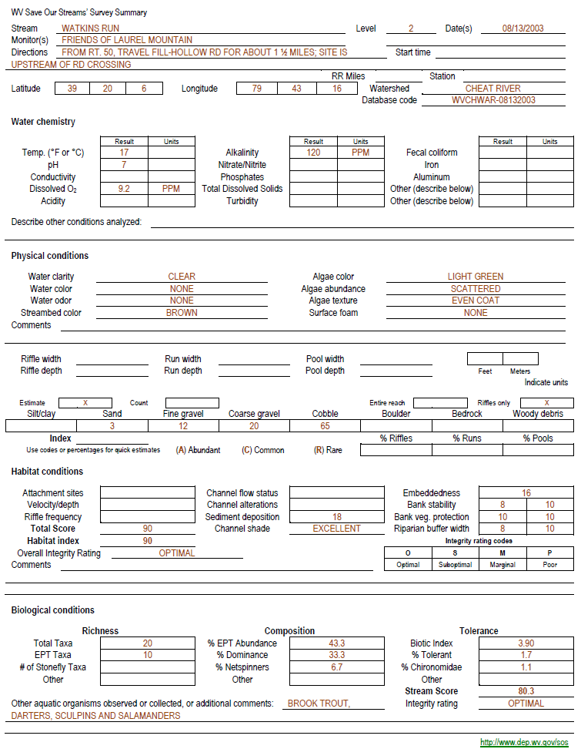
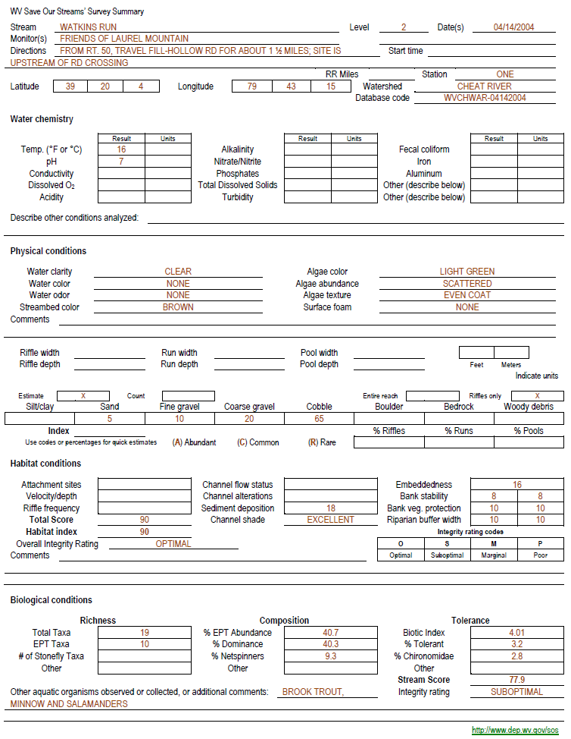
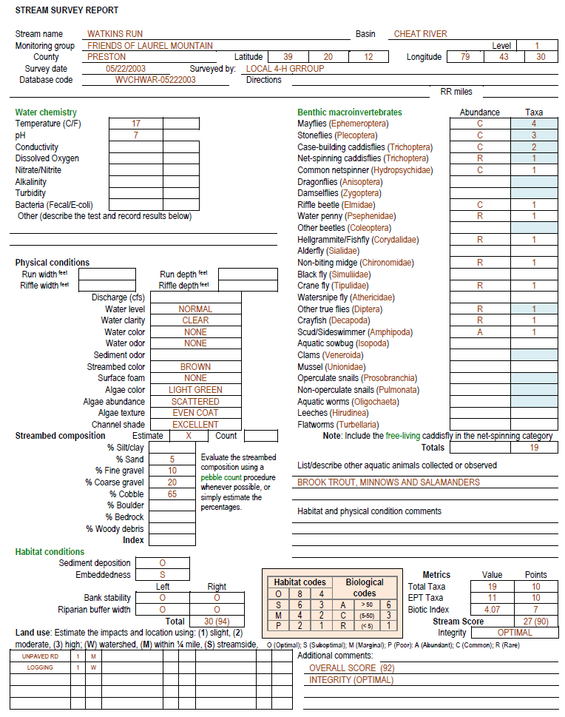
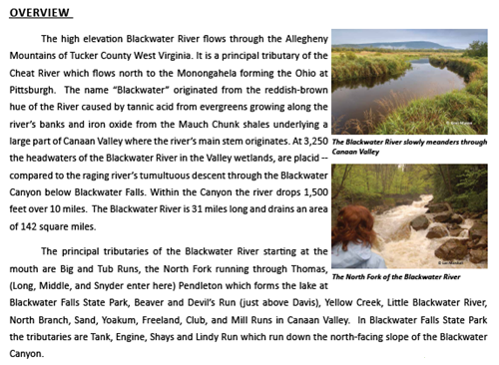
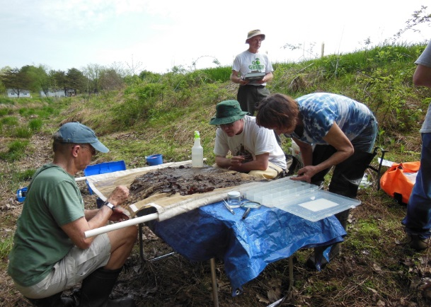
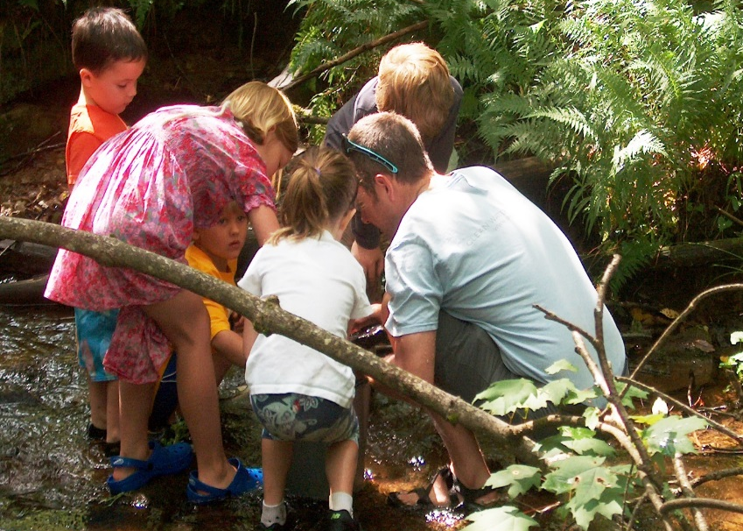
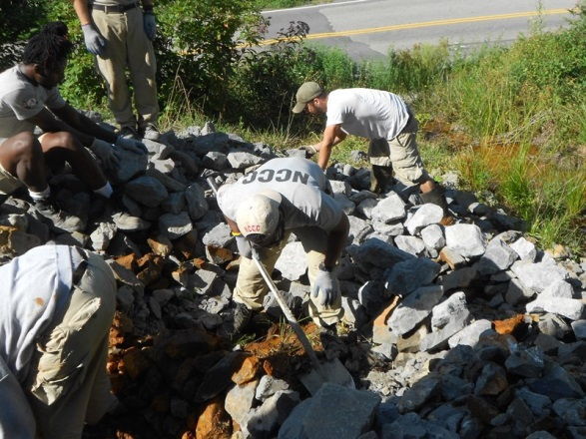
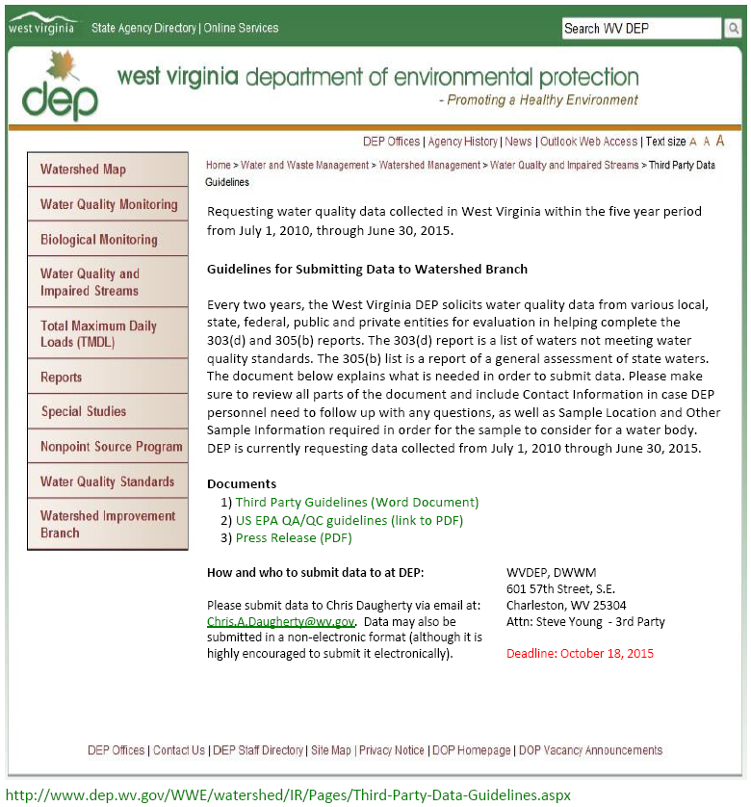
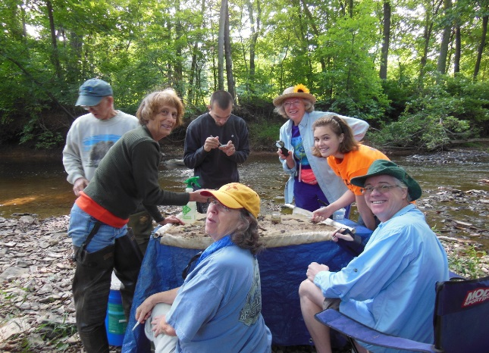
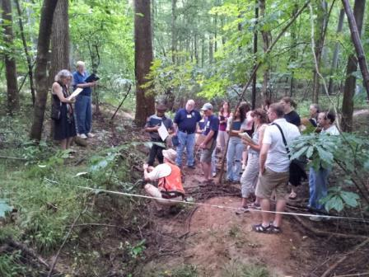
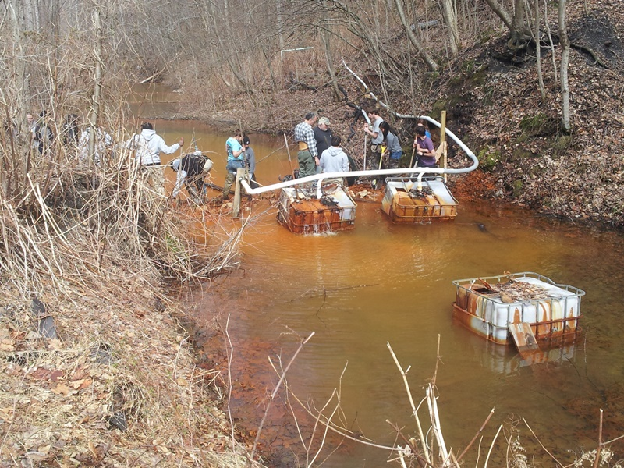
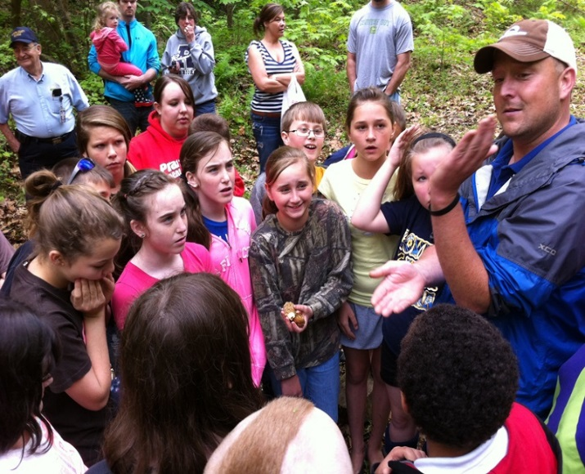
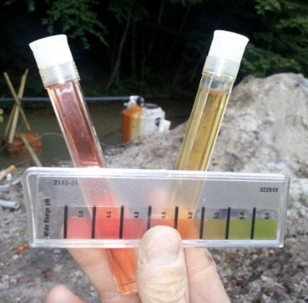
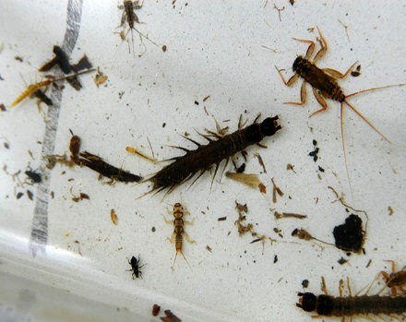
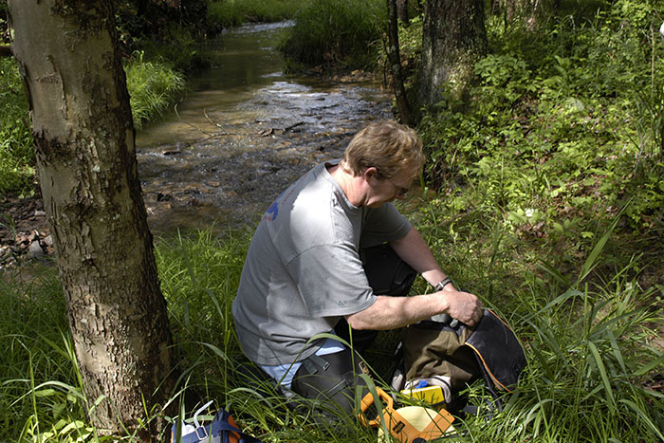
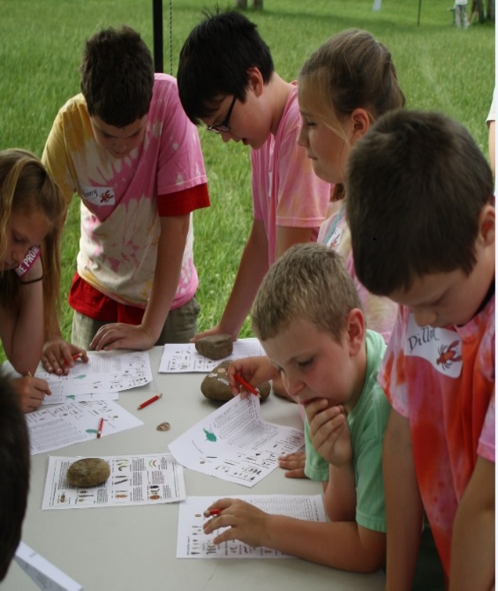
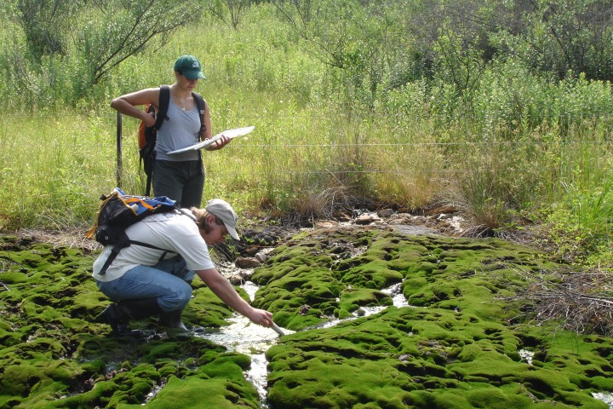
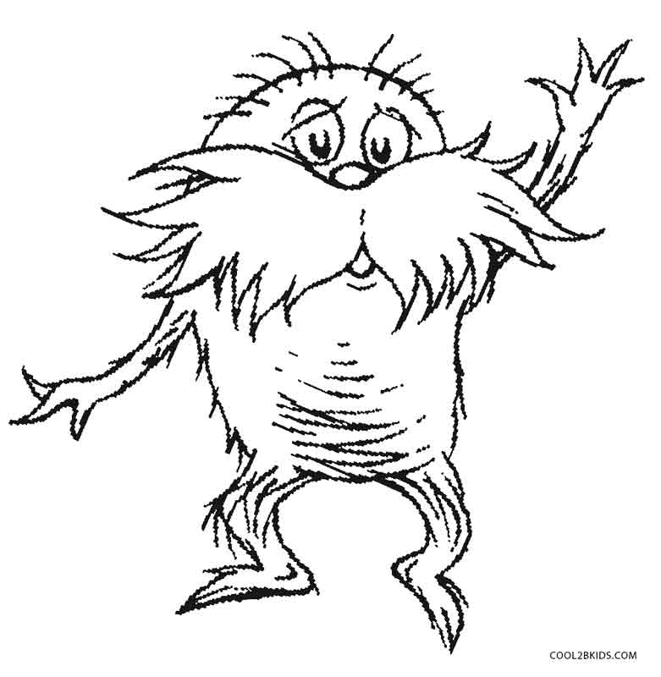
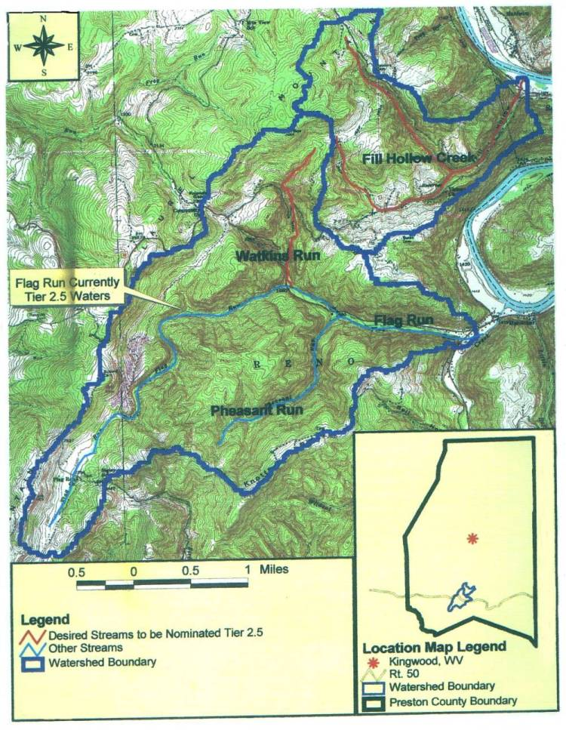
How West Virginia State Agencies use Volunteer Data
Timothy Craddock, Nonpoint Source Program Coordinator
WVDEP’s Watershed Improvement Branch
http://www.dep.wv.gov/WWE/Programs/nonptsource/Pages/usingvolunteerdata.aspx
Abstract
Since the Izaak Walton League of American (IWLA) introduced citizens to volunteer monitoring in the early 1970’s, West Virginia volunteers have actively participated. This participation increased dramatically when the state started its own program in 1995. Even though there was interest and enthusiasm state agencies have been hesitant to use volunteer generated data. When the second Citizens Monitoring Coordinator was hired in 2000 things began to change.
The Coordinator partnered with a variety of experts, supported a pier reviewed study that showed the weakness and strengths of the data, and held meetings and workshops statewide introducing more scientifically rigorous methods based on recommendations from experts. The new procedures were much more stringent evaluations based on SOPs from the WV Department of Environmental Protection (WVDEP) Watershed Branch, EPA’s Bioassessment Protocols and other expert recommendations. The final piece was a strong training and certification program.
Since introducing these procedures volunteer data has been accepted for the Integrated Report, Anti-degradation Tier 3 nominations, and 319 project monitoring, just to name a few uses. The volunteer groups are now much more sophisticated and have learned to use their data as a powerful tool to improve awareness and make positive changes to their local communities.
http://www.dep.wv.gov/WWE/Programs/wqs/Pages/default.aspx
Watershed Reports
Shown here are various sections from watershed and state of the stream reports provided by Plateau Action Network, Friends of Deckers Creek, Friends of the Cheat and Friends of Blackwater.. Contact: timothy.d.craddock@wv.gov to request a copy.
Many volunteer groups in WV have used local financial support, state funds and 319 funds to complete numerous projects designed to restore streams impaired by a multitude of nonpoint pollution sources, acid mine drainage being the most prominent. In addition to the rigors of projects and grant management, watershed planning etc. these groups are able to produce reports to inform their communities on the condition of the streams and rivers. Here are a few examples.
Images from the field
Integrated Report
FODC shovel crew performs project maintenance
State agencies charged with assessing the condition of their watersheds used two major reports to inform the public and EPA. The 303(d) list is a listing of impaired waters and the 305(b) report was a description of those conditions. The two reports became one, the Integrated Report in 2002. WV Save Our Streams volunteer data was first published in the 305(b) report in 2000, and volunteer data has been used in every Integrated Report since 2002.
This cluster graph compares the third party and volunteer data submitted since 2002. The volunteer contribution has been relatively consistent through the years. Overall approximately 30% of the external data accepted is volunteer generated.
SCWA identifies benthics to the family level
FOB collects with a local homeschool
MCWA retrofits an AMD treat- ment cell with the Nelson tank
2013 Mid-Atlantic volunteer monitoring conference
Current SOS Coordinator Glenn Nelson wows the group
A teacher prepares
FOC monitors a small seep
5th graders learn to identify macros
Results
Anti-Degradation
Since 2009 volunteer/agency partnerships are responsible for two 303(d) de-listings (Indian Run and Windmill Gap) and millions of pounds of pollutant reductions.
In 2009 Friends of Laurel Mountain and the local 4H group nominated Watkins Run for Tier 3 protection. After public meetings, and a final meeting before the Environmental Quality Board, WVDEP Water Quality Standard Program approved the nomination. Several WVDEP stream surveys and multiple volunteer surveys were the data sources. Summaries of the volunteer surveys are provided next. Thus far, this is the only successful Tier 3 nomination.
Unless someone like you cares a whole awful lot, nothing is going to get better, its not!
Acidity AMD metals Fecal coliform Nutrients Sediment Suspended solids | 646,458 211,837 3.88E+14 48 10 39,201 | lbs/year lbs/year cfu lbs/year tons/year lbs/year

