Slide 1
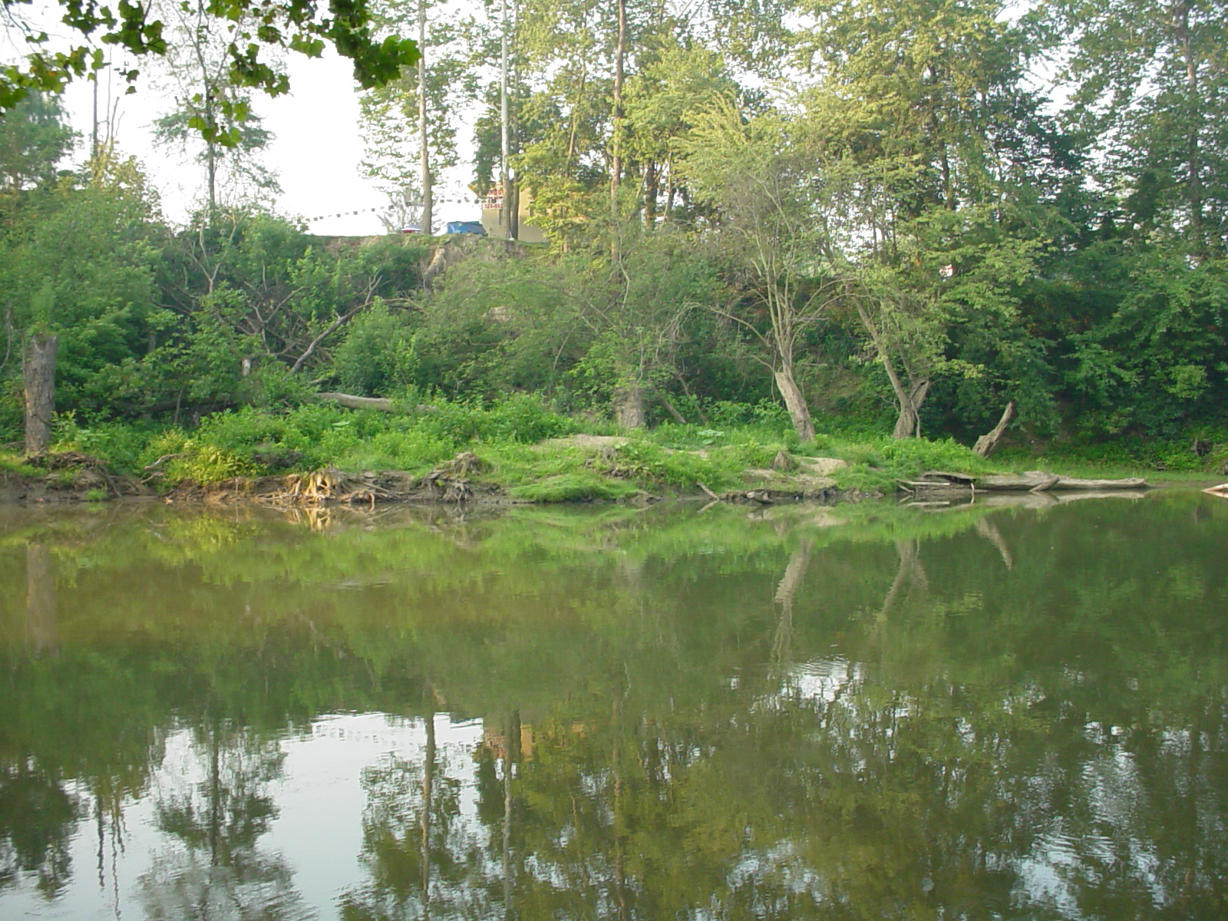
TMDL Development
Lower Guyandotte River Watershed
May 16, 2017

Slide 2
Agenda
Background information on Water Quality Standards, impaired waters and TMDLs
Brief history of WV TMDL development
Overview of WVDEP’s TMDL process
Discussion of local impaired waters and their TMDL timeline
Pre-TMDL Monitoring Plan for local waters
Discussion – Free form questions and answers

Slide 3
What’s a TMDL?
“Total Maximum Daily Load” – How much of a pollutant/s a stream can receive and remain healthy
TMDL is a pollutant budget – prescribes reduction in pollutants, where needed, that result in the restoration of an impaired stream
TMDL development is required by Clean Water Act for all impaired streams

Slide 4
What’s an impaired stream?
Stream that doesn’t meet water quality standards
West Virginia Water Quality Standards are codified in 47 CSR 2
Standards include designated uses for WV waters and water quality criteria to protect those uses
Criteria can be numeric or narrative
Impaired streams (streams that are not meeting criteria) get placed on the 303(d) List

Slide 5

Numeric Criteria
  Fecal Coliform Bacteria
    Human Health Protection (Water Contact)
    200 counts/100ml as a monthly geometric mean
    No more than 10% of samples in a month exceed 400 counts/100ml
  Total Iron
  Human Health/Aquatic Life Protection
    1.5 mg/l as a 4 day average concentration (warmwater)
    Not to be exceeded more than once every 3 years
    Not to exceed 1.5 mg/l (Public Water)

Slide 6
Numeric Criteria Example
  Selenium
    Aquatic Life/Public Drinking water
    Aquatic life criteria
      20 ug/l as a 1 hour average concentration
      5 ug/l as a 4 day average concentration
      Not to be exceeded more than once in three years
    Public Water - Not to exceed 50 ug/l

Slide 7
Narrative Criteria
Biological Impairment
  Conditions Not Allowable in State Waters
  (47 CSR 2-3.2i) “.....no significant adverse impact to the chemical, physical, hydrologic or biological components of aquatic ecosystems shall be allowed.”

Slide 8
WVDEP TMDL Process
Stream Selection
Pre-TMDL monitoring, source identification and characterization
Contract to model water quality and hydrology
Allocation process
Draft Report development
Finalization including EPA approval

Slide 9
Process Highlights
Synchronized with WV Watershed Management Framework
48 month process (Stream selection – EPA approval)
Multiple opportunities for public outreach/ stakeholder input
Pre-TMDL water quality monitoring
Source identification and characterization

Slide 10
TMDL Stream Selection Process
Spread development over State
Evaluate list of impaired waters
Consider Watershed Management Framework
Maximize efficiency
  focus geographically
  address all known or suspected impairments
Resources

Slide 11
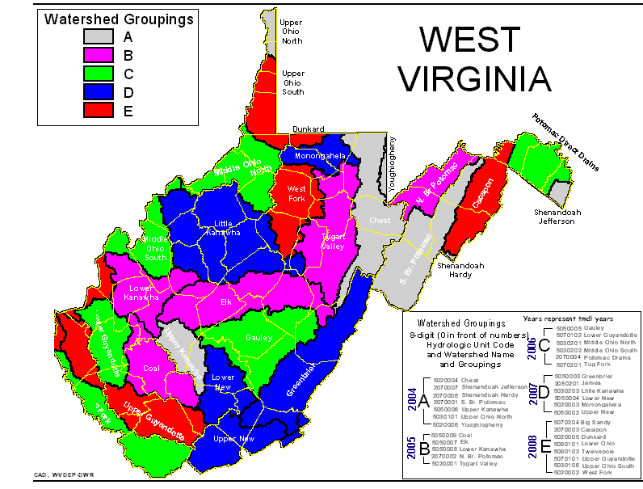
TMDL Development Stream Selection Process
Watershed Management Framework Consideration
TMDL Development Hydrologic Group C
Within HG C candidate watersheds = Gauley, Lower Guyandotte, Middle Ohio North, Middle Ohio South, Potomac Drains, Tug Fork

Slide 12
TMDL Stream Selection Process
DEP advertised proposal of Lower Guyandotte River Watershed for TMDL development & provided opportunity for public comment (February 5th – March 15th), No Comments received.
Watershed was selected for TMDL development
Due to resource constraints, a TMDL for Barboursville Lake is not proposed as part of this project.
TMDLs will be developed for any new water quality impairments identified in pre-TMDL monitoring.

Slide 13
HG C4 TMDL Timeline
Stream selection
1/31 – 3/3
Monitoring plan development
3/14 - 3/20
Outreach (TMDL process + monitoring plan)
5/16 – 6/16
Stream Monitoring and Source Tracking
7/2017 – 6/2018

Slide 14
HG C4 TMDL Timeline
Modeling
10/2018 – 3/2020
Outreach Meeting
7/2019 - 9/2019
Draft TMDLs (Internal Review)
3/2020
Outreach (Public Notice/Comment on Drafts)
5/2020 – 7/2020

Slide 15
HG C4 TMDL Timeline
Finalization (including EPA approval) 12/2020
Implementation begins
7/2022 – NPDES Water Permits
1/2023 – NPDES Mining Permits

Slide 16
Pre-TMDL Monitoring Plan
Goal – to generate robust/current data to:
  Make accurate impairment assessments
  Calibrate watershed models
  Quantify the impacts of significant pollutant sources
Today’s presentation is a preliminary plan; to be refined via WVDEP field recon and stakeholder input

Slide 17
Pre-TMDL Monitoring Plan
Monitoring period : July 2017 – June 2018
Sampling frequency
  Water chemistry (monthly) & selected parameters (quarterly)
  Flow measurement (selected locations monthly)
  Benthic macroinvertebrates (at least once during appropriate sampling period)
  RBP habitat evaluations (at time of benthic macroinvertebrate assessments)
Notes:
If asked about monthly chemistry parameters answer that it varies with the prescribed sampling suites (whitman’s one pager)
If asked why do TDS ions – answers are 1) document current conditions and 2)use in stressor ID for benthics

Slide 18
Pre-TMDL Monitoring Plan
Sample site map on DEP webpage - GIS available
Impairment/potential impairment sampling parameters include
TSS,
T. & Dis. Iron
Fecal coliform
T. & Dis. Aluminum
  T. Manganese upstream of water intakes
  T. Selenium (selected sites & background)
  Biology – benthic macroinvertebrates collected at least once during applicable season to evaluate narrative criteria
    Fish to be assessed at some sites
  305 sites on 230 streams

Slide 19
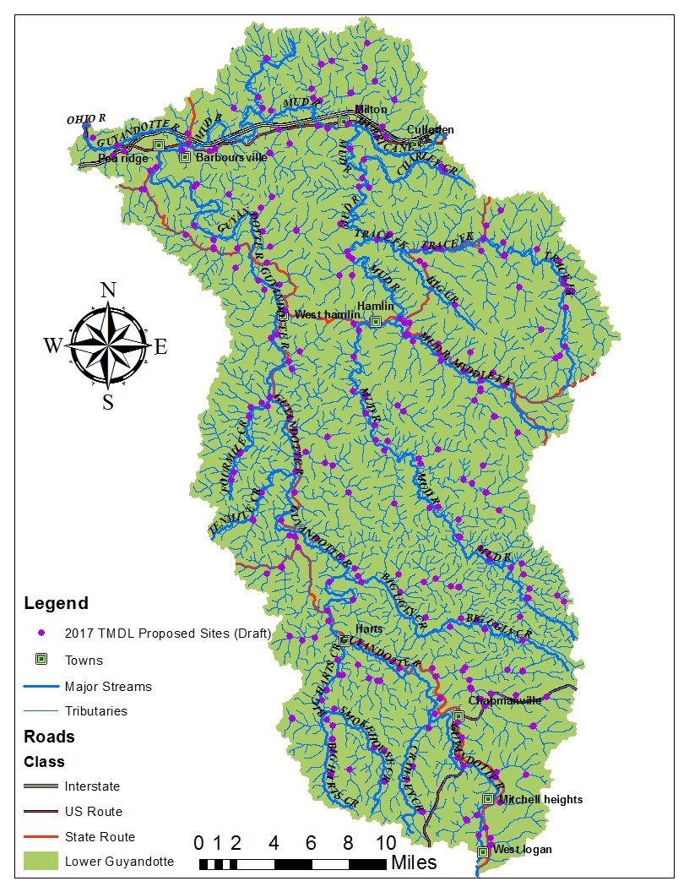

Slide 20
Source Tracking Efforts
Abandoned Mine Lands
Limits of sewage collection systems
Assessment of failing onsite systems
AFOs, Livestock counts, livestock stream access
Riparian zone condition (Runoff potential)
Unmapped road density
Qualitative assessment of sediment sources
Active Mining Point Source Info

Slide 21
Stakeholder Input
General comments regarding plan’s adequacy in addressing goals
Does the plan provide for monitoring of particularly bad or good streams that you know about?
Does the plan provide monitoring sufficient to characterize significant pollutant sources?
Do you have water quality data to contribute?

Slide 22
Future Input Opportunities
Outreach meeting/s
– Summer 2019
Public Meeting to present Draft TMDL and formal Public Notice/Public Comment
– Summer 2020

Slide 23
WVDEP Contact Information
Contact: Steve Young – Stephen.A.Young@wv.gov
Tele: (304) 926-0499 Ext 1042;
FAX: (304) 926-0496
601 57th Street SE, Charleston WV 25304
www.dep.wv.gov
  Select Water and Waste Home
  On left select Watershed Management, click on
  “ Total Maximum Daily Load”

Slide 24
Questions???

