Slide 1
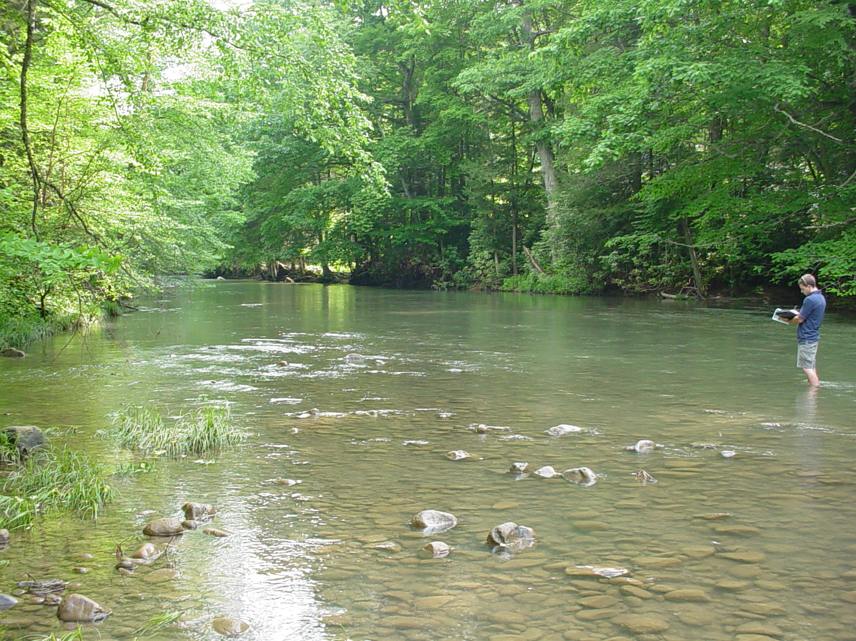
TMDL Development
Meadow River Watershed
May 14, 2013

Slide 2
Agenda
Background information on Water Quality Standards, impaired waters and TMDLs
Brief history of WV TMDL development
Overview of WVDEP’s TMDL process
Discussion of local impaired waters and their TMDL timeline
Pre-TMDL Monitoring Plan for local waters
Discussion – Free form questions and answers

Slide 3
What’s a TMDL?
“Total Maximum Daily Load” – How much of a pollutant/s a stream can receive and remain healthy
TMDL development is required by Clean Water Act for all impaired streams
TMDL is a pollutant budget – prescribes reduction in pollutants that result in the restoration of an impaired stream

Slide 4
What’s an impaired stream?
Stream that doesn’t meet water quality standards
West Virginia Water Quality Standards are codified in 47 CSR 2
Standards include designated uses for WV waters and water quality criteria to protect those uses
Criteria can be numeric or narrative
Impaired streams (streams that are not meeting criteria) are on the 303(d) List

Slide 5
Numeric Criteria
Human Health Protection
Fecal Coliform bacteria (Water Contact)
200 counts/100ml as a monthly geometric mean
no more than 10% of samples in a month exceed 400 counts/100ml
Human Health/Aquatic Life Protection
Total Iron
1.5 mg/l as a 4 day average concentration (warmwater)
1.0 mg/l as a 4 day average concentration (troutwater)
Not to be exceeded more than once every 3 years

Slide 6
Numeric Criteria
Human Health
Total Manganese
1.0 mg/l (Human Health) drinking water
Effective within a 5 mile zone above a public intake
Aquatic Life
Dissolved Aluminum
750 ugl/l as a 4 day avg. concentration (warmwater) 87 ug/l as a 4 avg. concentration (troutwater)
Not to be exceeded more than once every 3 years

Slide 7
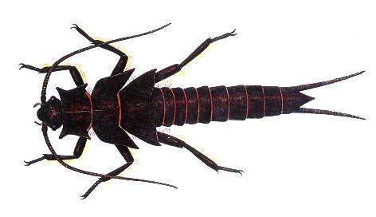
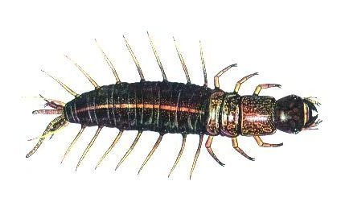
Narrative Criteria
Biological Impairment
Conditions Not Allowable in State Waters
(47 CSR 2-3.2i) “.....no significant adverse impact to the chemical, physical, hydrologic or biological components of aquatic ecosystems shall be allowed.”

Slide 8
Previous 47 CSR 2 - 3.2.i Assessment
Based on Benthic Macroinvertebrates
West Virginia Stream Condition Index (WVSCI)
Standardized method for assessing benthic macroinvertebrates (aquatic bugs)
WVSCI stream scores normalized to 0 - 100 range
Streams scoring less than the 60.6 threshold value labeled as “impaired” and placed on the 303(d) list
Streams listed as impaired slated for TMDLs
“Biologically Impaired” streams evaluated for source/s of impairment during the TMDL development process (Stressor Identification Process)

Slide 9
2012 Legislative Changes
Senate Bill 562 passed by 2012 the West Virginia Legislature amended the WV Water Pollution Control Act
Requires “evaluation of the holistic health of the aquatic ecosystem”
Requires DEP to develop and secure legislative approval of new rules to interpret 47 CSR 2-3.2.i
http://www.legis.state.wv.us/wvcode/ChapterEntire.cfm?chap=22&art=11
Notes:
Web link is cumbersome – may want to have a dozen or so copies to hand out

Slide 10
Biological Impairment Path Forward
DEP currently working to develop a methodology which meets the legislative requirements set forth in SB562; considering incorporating fish assessments
WV Draft 2012 303(d) List contained no new bio listings
No new WV developed TMDLs until new methodology effective
Will continue benthic monitoring in interim
Likely to remain a component of new method
May be able to address existing 303(d) listings if stream no longer impaired per WVSCI or if WVSCI stressors can be resolved by attainment of numeric criterion

Slide 11
West Virginia TMDL History
TMDL development required by Clean Water Act for all impaired streams
If State doesn’t develop TMDLs, EPA must
WV couldn’t (resources), EPA didn’t
EPA was sued in 1995, settled suit by entering into consent decree with plaintiffs, and began developing WV TMDLs
In 2004, WV finalized its first group of TMDLs developed under state direction

Slide 12
WVDEP TMDL Process
Stream Selection
Pre-TMDL monitoring, source identification and characterization
Contract to model water quality and hydrology
Allocation
Report development
Finalization

Slide 13
Process Highlights
Synchronized with WV Watershed Management Framework
48 month process (Stream selection – EPA approval)
Multiple opportunities for public outreach/ stakeholder input
Pre-TMDL water quality monitoring
Source identification and characterization

Slide 14
TMDL Stream Selection Process
Spread development over State
Evaluate list of impaired waters
Consider WMF
Maximize efficiency
focus geographically
address all known or suspected impairments
Resources

Slide 15
TMDL Development Stream Selection Process
Watershed Management Framework Consideration
TMDL Development Hydrologic Group C3
Within HG C3 candidate watersheds = Gauley, Lower Guyandotte, Middle Ohio North, Middle Ohio South, Potomac Direct Drains, Tug Fork

Slide 16
TMDL Development Stream Selection Process
Statewide Coverage Considerations
DEP TMDL development has occurred in Gauley, Guyandotte, Middle Ohio North, Middle Ohio South, Potomac Direct Drains and Tug Fork watersheds.
Mainstem Meadow River and selected tributaries on the current 303d list
Biological assessment methodology is in transition

Slide 17
TMDL Development Stream Selection Process
DEP proposed TMDL development in Meadow River, Warm Spring Run and Rockymarsh Run watersheds.
DEP advertised proposal and provided opportunity for comment March 21 through April 19 - No Comments received.
Final selection – Meadow River watershed and tributaries from headwaters to its confluence, with exception of Sewell Creek, and select Potomac Direct drain streams.
TMDLs will be developed for any new impairments identified in pre-TMDL monitoring (with possible exception of Bio Impairment

Slide 18
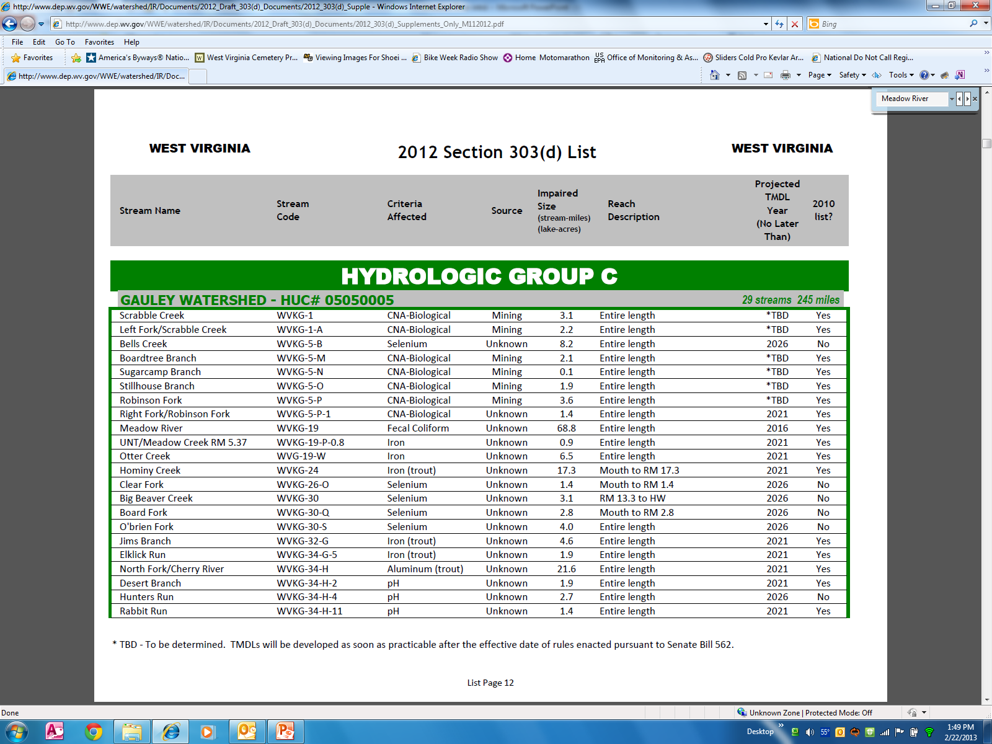

Slide 19
HG C3 TMDL Timeline
Stream selection
3/13 – 4/13
Monitoring plan development
3/13 - 5/13
Outreach (TMDL process + monitoring plan specifics)
5/13 – 6/13
Stream Monitoring and Source Tracking
7/13 – 6/14

Slide 20
HG C3 TMDL Timeline
Modeling
10/14 – 6/15
Outreach (Status Update)
7/15 - 9/15
Draft TMDLs (Internal Review)
3/16
Outreach (PN/PC on Drafts)
4/16 – 6/16

Slide 21
HG C3 TMDL Timeline
Finalization (including EPA approval) 12/16
Implementation begins
7/17 – NPDES Water Permits
1/18 – NPDES Mining Permits

Slide 22
Pre-TMDL Monitoring Plan
Goal – to generate robust/ recent data to:
Make accurate impairment assessments
Calibrate watershed models
Quantify the impacts of significant pollutant sources
Today’s presentation is a preliminary plan; to be refined via WVDEP field recon and stakeholder input

Slide 23
Pre-TMDL Monitoring Plan
Monitoring period = July 2013 – June 2014
Sampling frequency
Water chemistry (monthly)
Flow measurement (selected locations, monthly)
Benthic macroinvertebrates (once in WVSCI Index period)
RBP habitat evaluations (once with benthic assessment)
Notes:
If asked about monthly chemistry parameters answer that it varies with the prescribed sampling suites (whitman’s one pager)
If asked why do TDS ions – answers are 1) document current conditions and 2)use in stressor ID for benthics

Slide 24
Pre-TMDL Monitoring Plan
Detailed map on DEP webpage - GIS available
Impairment/potential impairment sampling suites:
Sed – TSS, T. & Dis. Iron
Fecal - fecal coliform
AMD – Hot Acidity, Alkalinity, Sulfate, Chloride, TDS, TSS, Ammonia*, T. & Dis. Al, T & Dis. Iron, T. Se, Mg, Ca, Na*, K*
Bio - aquatic bug collection for reevaluation of stream status
Comp – AMD, Fecal, Sed, Cold Acidity, T. Phos, TKN, Nitrate, Nitrite, T. Mn,
80 sites on 53 streams

Slide 25
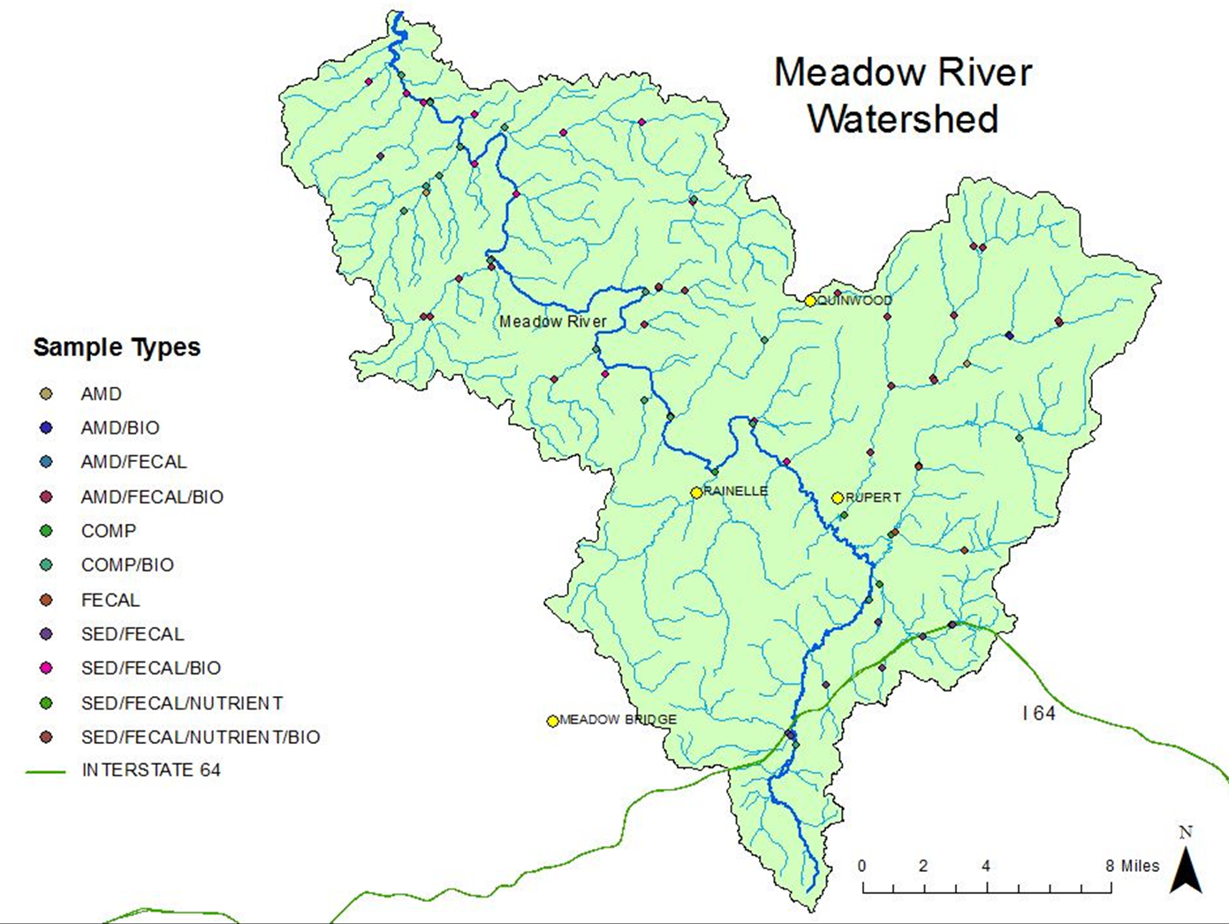

Slide 26
Source Tracking Efforts
Abandoned Mine Lands
Limits of POTW collection systems
Assessment of failing onsite systems
AFOs, Livestock counts, livestock stream access
Riparian zone condition
Unmapped road density
Qualitative assessment of sediment sources
Active Mining Point Source Info

Slide 27
Stakeholder Input
General comments regarding plan’s adequacy in addressing goals
Does the plan provide for monitoring of particularly bad or good streams that you know about?
Does the plan provide monitoring sufficient to characterize significant pollutant sources?
Do you have water quality data to contribute?

Slide 28
Future Input Opportunities
Public meeting to present TMDL status update
– Summer 2015
Public Meeting to present Draft TMDL and formal Public Notice/Public Comment
– Spring 2016

Slide 29
WVDEP Contact Information
Contact: Steve Young – Stephen.A.Young@wv.gov
Tele: (304) 926-0499 Ext 1042;
FAX: (304) 926-0496
601 57th Street SE, Charleston WV 25304
www.dep.wv.gov
Select Water and Waste Home
On left select Watershed Management, click on “ Total Maximum Daily Load”

Slide 30
Questions???

