Slide 1
TMDL Development
Mainstem Monongahela River Watershed
May 14, 2014

Slide 2
Agenda
Background information on Water Quality Standards, impaired waters and TMDLs
Brief history of WV TMDL development
Overview of WVDEP’s TMDL process
Discussion of local impaired waters and their TMDL timeline
Pre-TMDL Monitoring Plan for local waters
Discussion – Free form questions and answers

Slide 3
What’s a TMDL?
“Total Maximum Daily Load” – How much of a pollutant/s a stream can receive and remain healthy
TMDL development is required by Clean Water Act for all impaired streams
TMDL is a pollutant budget – prescribes reduction in pollutants that result in the restoration of an impaired stream

Slide 4
What’s an impaired stream?
Stream that doesn’t meet water quality standards
West Virginia Water Quality Standards are codified in 47 CSR 2
Standards include designated uses for WV waters and water quality criteria to protect those uses
Criteria can be numeric or narrative
Impaired streams (streams that are not meeting criteria) are on the 303(d) List

Slide 5
Numeric Criteria
Human Health Protection (Monongahela Mainstem)
Fecal Coliform bacteria (Water Contact)
200 counts/100ml as a monthly geometric mean
no more than 10% of samples in a month exceed 400 counts/100ml
Human Health/Aquatic Life Protection (Unt/Deckers Creek)
Dissolved Lead
Public Drinking water
Not to exceed 50 ug/l (public drinking water)
Aquatic life criteria
1 hour average and 4 day average criteria vary based on hardness [chronic = 0.54 ug/l (25) to 10.94 ug/l (400)]
Not to be exceeded more than once in three years

Slide 6
West Virginia TMDL History
TMDL development required by Clean Water Act for all impaired streams
If State doesn’t develop TMDLs, EPA must
WV couldn’t (resources), EPA didn’t
EPA was sued in 1995, settled suit by entering into consent decree with plaintiffs, and began developing WV TMDLs
In 2004, WV finalized its first group of TMDLs developed under state direction

Slide 7
WVDEP TMDL Process
Stream Selection
Pre-TMDL monitoring, source identification and characterization
Contract to model hydrology and water quality
Allocation development
Report development
Finalization

Slide 8
Process Highlights
Synchronized with WV Watershed Management Framework
48 month process (Stream selection – EPA approval)
Multiple opportunities for public outreach/ stakeholder input
Pre-TMDL water quality monitoring
Source identification and characterization

Slide 9
TMDL Stream Selection Process
Spread development over State
Evaluate list of impaired waters
Consider WMF
Maximize efficiency
focus geographically
address all known or suspected impairments
Resources

Slide 10
TMDL Development Stream Selection Process
Watershed Management Framework Consideration
TMDL Development Hydrologic Group D3
Within HG D3 candidate watersheds = Greenbrier, James, Little Kanawha, Lower New, Monongahela, Upper New

Slide 11
TMDL Development Stream Selection Process
Monongahela Tributaries TMDL approved
West Fork watershed TMDL being prepared for submission to EPA
Tygart TMDL Model development to begin this fall
Once this project is finalized in 2017, TMDLs will be completed for entire Monongahela River watershed in WV

Slide 12
TMDL Development Stream Selection Process
DEP proposed TMDL development for Monongahela Mainstem, Unt/Deckers Creek RM 18.48 and Hughes River watersheds.
DEP advertised proposal and provided opportunity for comment (February 27 through March 28) - No Comments received.
Final selection – Monongahela River mainstem, Unt/Deckers Creek RM 18.48 and Hughes River watersheds.
TMDLs will be developed for any new impairments identified in pre-TMDL monitoring

Slide 15
HG D3 TMDL Timeline
Stream selection
2/14 – 3/14
Monitoring plan development
3/14 - 4/14
Outreach (TMDL process + monitoring plan specifics)
5/14 – 6/14
Stream Monitoring and Source Tracking
7/14 – 6/15

Slide 16
HG D3 TMDL Timeline
Modeling
10/15 – 6/16
Outreach (Status Update)
7/16 - 9/16
Draft TMDLs (Internal Review)
3/17
Outreach (PN/PC on Drafts)
4/17 – 6/17

Slide 17
HG D3 TMDL Timeline
Finalization (including EPA approval) 12/17
Implementation begins
7/18 – NPDES Water Permits
1/19 – NPDES Mining Permits

Slide 18
Pre-TMDL Monitoring Plan
Goal – to generate robust/ recent data to:
Make accurate impairment assessments
Calibrate watershed models
Quantify the impacts of significant pollutant sources
Today’s presentation is a preliminary plan; to be refined via WVDEP field recon and stakeholder input

Slide 19
Pre-TMDL Monitoring Plan
Monitoring period = July 2014 – June 2015
Sampling frequency
Water chemistry (monthly)
Flow measurement (selected sites on Unt/Deckers)
Notes:
If asked about monthly chemistry parameters answer that it varies with the prescribed sampling suites (whitman’s one pager)
If asked why do TDS ions – answers are 1) document current conditions and 2)use in stressor ID for benthics

Slide 20
Pre-TMDL Monitoring Plan
Detailed map on DEP webpage - GIS available
Field Readings (Temp, D.O. pH and conductance)
Monongahela Mainstem (16 sites)
Fecal - fecal coliform (deployables collecting temperature at selected sites for fecal decay calculations)
Unt/Deckers Creek at RM 18.48 (5 sites in 3 streams)
Lead, Calcium, Magnesium, Flow

Slide 22
Source Tracking Efforts
Limits of POTW collection systems
Combined Sewer Overflow areas/discharges
MS4 areas/discharges
Assessment of failing onsite systems
AFOs, Livestock counts, livestock stream access
Riparian zone condition

Slide 23
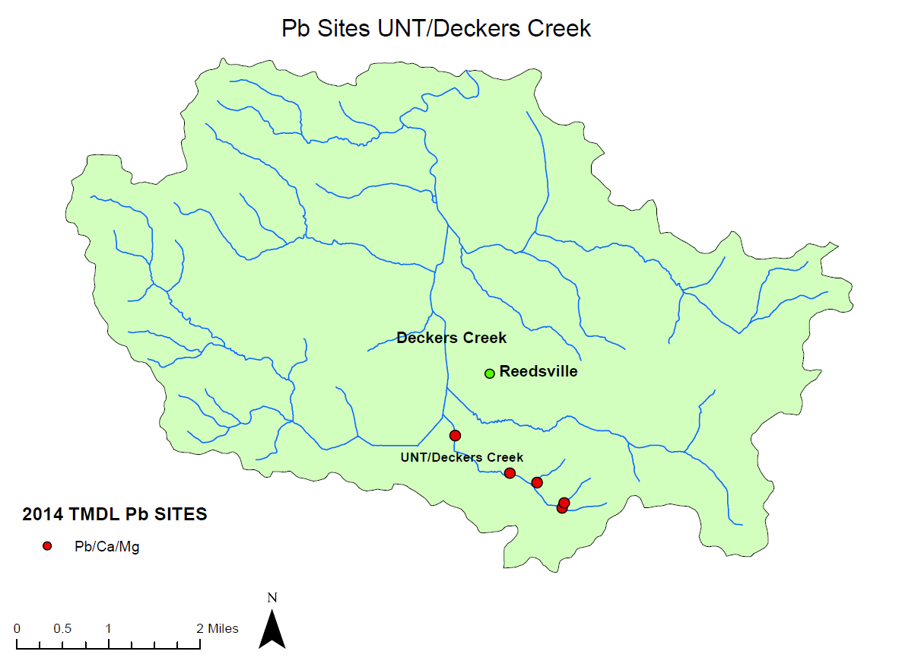

Slide 24
Source Tracking Efforts
Thorough review of all site assessment reports
Qualitative assessment of sediment sources
Unmapped road density
Abandoned Mine Lands

Slide 25
Stakeholder Input
General comments regarding plan’s adequacy in addressing goals
Does the plan provide for monitoring of particularly bad or good streams that you know about?
Does the plan provide monitoring sufficient to characterize significant pollutant sources?
Do you have water quality data to contribute?

Slide 26
Future Input Opportunities
Public meeting to present TMDL status update
– Summer 2016
Public Meeting to present Draft TMDL and formal Public Notice/Public Comment
– Spring 2017

Slide 27
WVDEP Contact Information
Contact: Steve Young – Stephen.A.Young@wv.gov
Tele: (304) 926-0499 Ext 1042;
FAX: (304) 926-0496
601 57th Street SE, Charleston WV 25304
www.dep.wv.gov
Select Water and Waste Home
On left select Watershed Management, click on “ Total Maximum Daily Load”

Slide 28
Questions???

