Slide 1
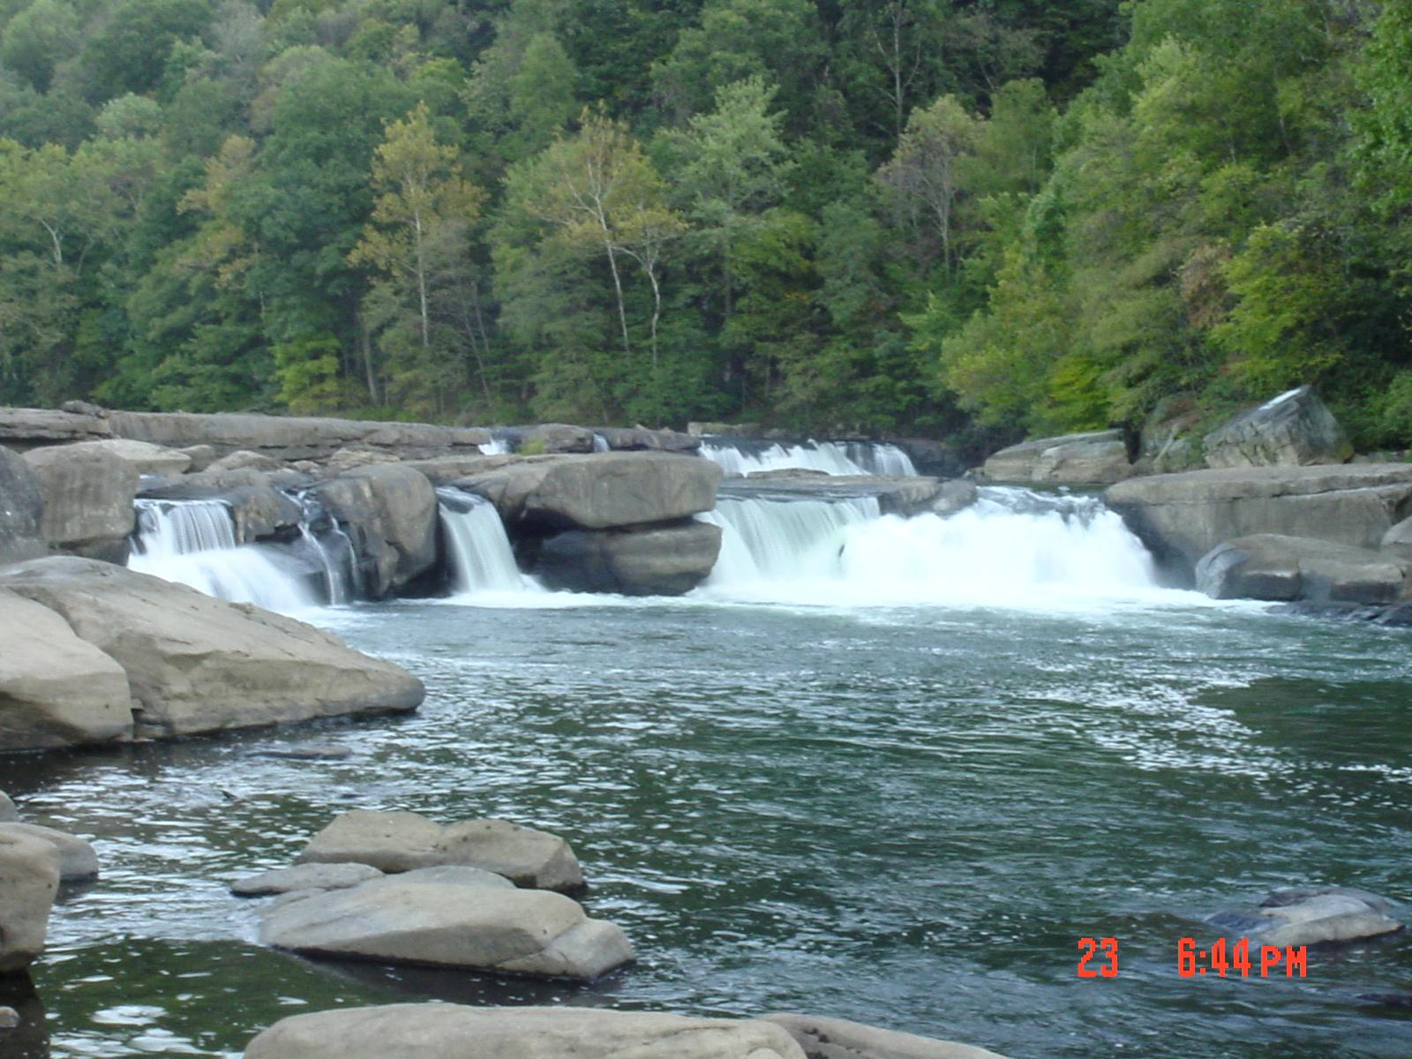
TMDL Development
Tygart Valley River Watershed
May 9th & 10th 2012
WV DEP
James Laine

Slide 2
Agenda
Background information on Water Quality Standards, impaired waters and TMDLs
Brief history of WV TMDL development
Overview of WVDEP’s TMDL process
Discussion of local impaired waters and their TMDL timeline
Pre-TMDL Monitoring Plan for local waters
Discussion – Free form questions and answers

Slide 3
What’s a TMDL?
“Total Maximum Daily Load” – How much of a pollutant/s a stream can receive and remain healthy
TMDL development is required by Clean Water Act for all impaired streams
TMDL is a pollutant budget – prescribes reduction in pollutants that result in the restoration of an impaired stream

Slide 4
What’s an impaired stream?
Stream that doesn’t meet water quality standards
West Virginia Water Quality Standards are codified in 47 CSR 2
Standards include designated uses for WV waters and water quality criteria to protect those uses
Criteria can be numeric or narrative
Impaired streams (streams that are not meeting criteria) are on the 303(d) List

Slide 5
Numeric Criteria
Human Health Protection
Fecal Coliform bacteria (Water Contact)
200 counts/100ml as a monthly geometric mean
no more than 10% of samples in a month exceed 400 counts/100ml
Human Health/Aquatic Life Protection
Total Iron
1.5 mg/l as a 4 day average concentration (warmwater)
1.0 mg/l as a 4 day average concentration (troutwater)
Not to be exceeded more than once every 3 years

Slide 6
Numeric Criteria
Human Health
Total Manganese
1.0 mg/l (Human Health) drinking water
Effective within a 5 mile zone above a public intake
Aquatic Life
Dissolved Aluminum
750 ugl/l as a 4 day avg. concentration (warmwater) 87 ug/l as a 4 avg. concentration (troutwater)
Not to be exceeded more than once every 3 years

Slide 7
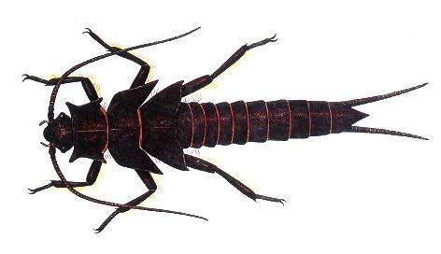
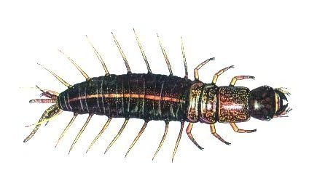
Narrative Criteria
Biological Impairment
Conditions Not Allowable in State Waters
(47 CSR 2-3.2i) “.....no significant adverse impact to the chemical, physical, hydrologic or biological components of aquatic ecosystems shall be allowed.”

Slide 8
Previous 47 CSR 2 - 3.2.i Assessment
Based on Benthic Macroinvertebrates
West Virginia Stream Condition Index (WVSCI)
Standardized method for assessing benthic macroinvertebrates (aquatic bugs)
WVSCI stream scores normalized to 0 - 100 range
Streams scoring less than the 60.6 threshold value labeled as “impaired” and placed on the 303(d) list
Streams listed as impaired slated for TMDLs
“Biologically Impaired” streams evaluated for source/s of impairment during the TMDL development process (Stressor Identification Process)

Slide 9
Recent Legislative Changes
Senate Bill 562 passed by 2012 the West Virginia Legislature amended the WV Water Pollution Control Act
Requires “evaluation of the holistic health of the aquatic ecosystem”
Requires DEP to develop and secure legislative approval of new rules to interpret 47 CSR 2-3.2.i
http://www.legis.state.wv.us/Bill_Text_HTML/2012_SESSIONS/RS/pdf_bills/SB562%20SUB1%20enr%20PRINTED.pdf
Notes:
Web link is cumbersome – may want to have a dozen or so copies to hand out

Slide 10
Biological Impairment Path Forward
DEP currently working to develop a methodology which meets the legislative requirements set forth in SB562; considering incorporating fish assessments
No new 303(d) listings under old methodology
No new TMDLs until new methodology effective
Will continue benthic monitoring in interim
Likely to remain a component of new method
May be able to address existing 303(d) listings if stream no longer impaired per WVSCI or if WVSCI stressors can be resolved by attainment of numeric criterion

Slide 11
West Virginia TMDL History
TMDL development required by Clean Water Act for all impaired streams
If State doesn’t develop TMDLs, EPA must
WV couldn’t (resources), EPA didn’t
EPA was sued in 1995, settled suit by entering into consent decree with plaintiffs, and began developing WV TMDLs
In 2004, WV finalized its first group of TMDLs developed under state direction

Slide 12
WVDEP TMDL Process
Stream Selection
Pre-TMDL monitoring, source identification and characterization
Contract to model water quality and hydrology
Allocation
Report development
Finalization

Slide 13
Process Highlights
Synchronized with WV Watershed Management Framework
48 month process (Stream selection – EPA approval)
Multiple opportunities for public outreach/ stakeholder input
Pre-TMDL water quality monitoring
Source identification and characterization

Slide 14
TMDL Stream Selection Process
Spread development over State
Evaluate list of impaired waters
Consider WMF
Maximize efficiency
focus geographically
address all known or suspected impairments
Resources

Slide 15
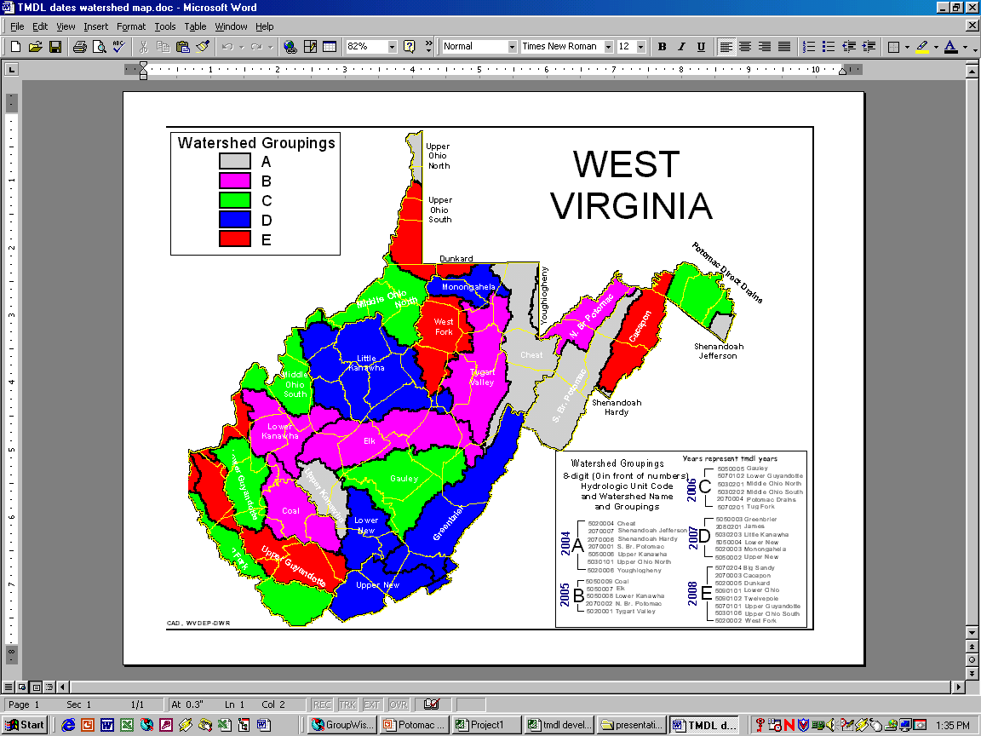
Watershed Management Framework
32 watersheds (8-digit HUC)
5 Hydrologic Groups (A – E)
Geographical way to organize water resource management – Within DEP, watershed assessment, NPDES Permit reissuance and nonpoint source project funding synchronized
WVDEP TMDL development synchronized

Slide 16
TMDL/WMF Synchronization
Pre-TMDL monitoring occurs concurrently with WMF assessment year
TMDL completion six months prior to start of WMF implementation year
5yr WMF cycle/15 year plan
3 bites at each HG apple

Slide 17
TMDL Development Stream Selection Process
Watershed Management Framework Consideration
TMDL Development Hydrologic Group B3
Within HG B3, candidate watersheds = Coal, Elk, Lower Kanawha, North Branch Potomac, Tygart Valley

Slide 18
TMDL Development Stream Selection Process
Statewide Coverage Considerations
DEP TMDL development has occurred in Coal, Elk, Lower Kanawha and North Branch Potomac watersheds.
Significant number of Tygart streams/impairments on the 303d list; EPA-developed TMDLs for the Tygart Valley watershed need revision due to changes in aluminum and manganese water quality standards

Slide 19
TMDL Development Stream Selection Process
DEP proposed TMDL development in Tygart Valley River watershed
DEP advertised proposal and provided opportunity for comment (March 7 – April 13, 2012) - No Comments received
Final selection – Tygart Valley River and tributaries from headwaters to its confluence with the Monongahela River

Slide 20
TMDL Development Stream Selection Process
Address all 2010 303(d) listings except PCBs in Tygart Valley Lake. New data indicates a non-impaired condition and delisting will be proposed in draft 2012 303(d) list
2001 EPA TMDLs will also be re-evaluated during this effort
TMDLs will be developed for any new impairments identified in pre-TMDL monitoring (with possible exception of Bio Impairment)

Slide 21
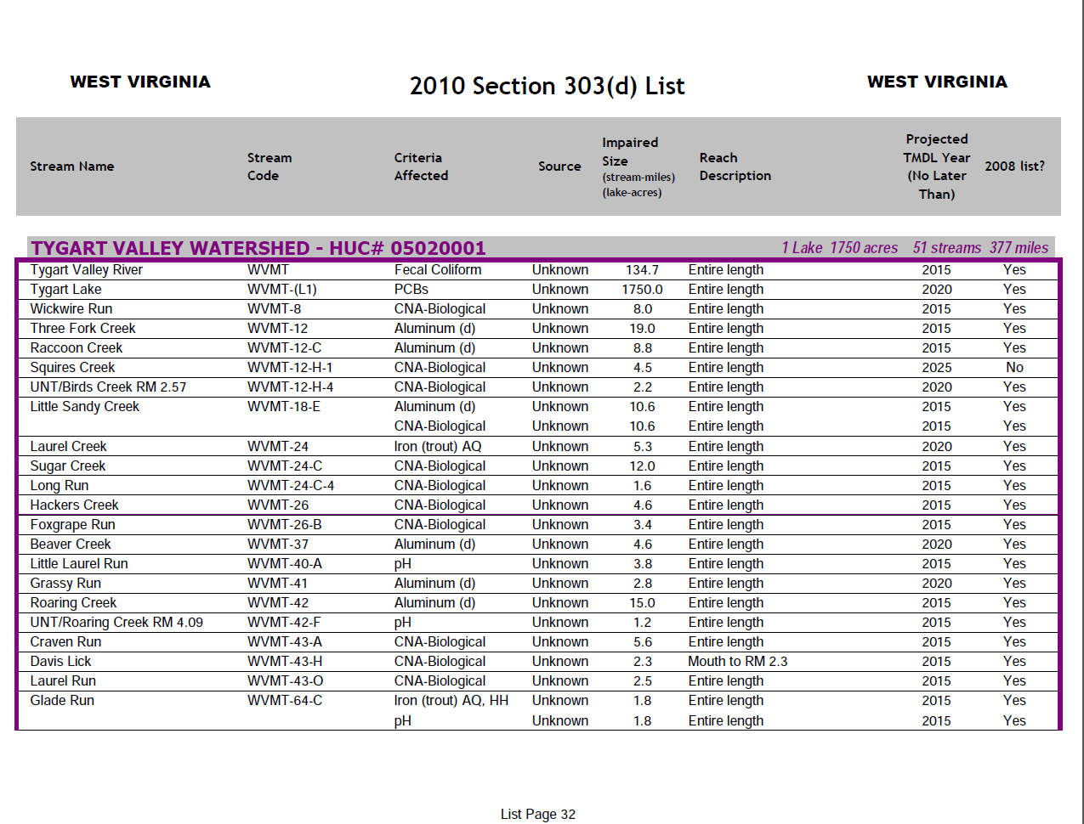

Slide 22
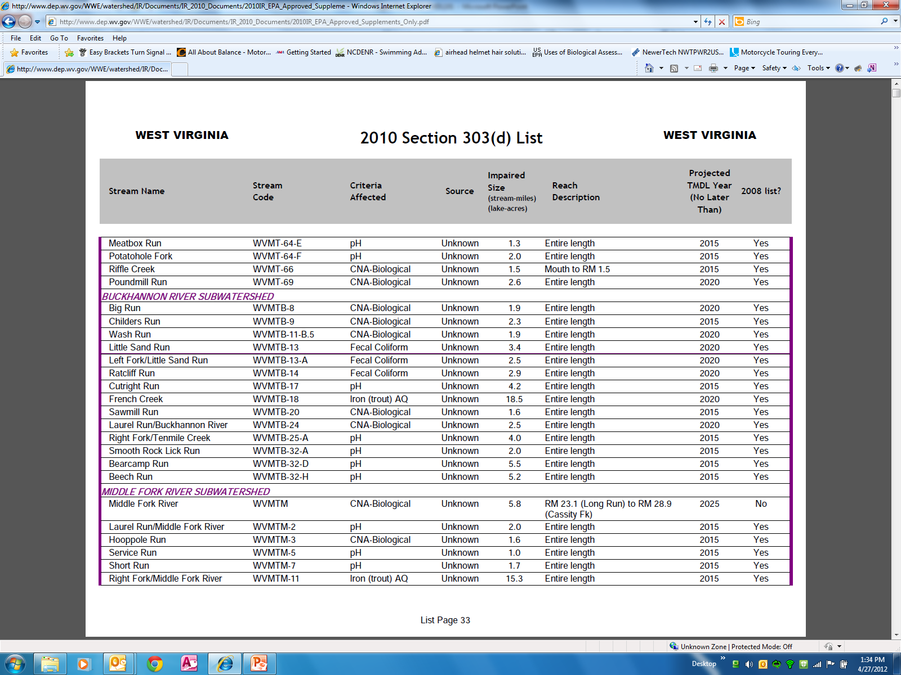

Slide 23
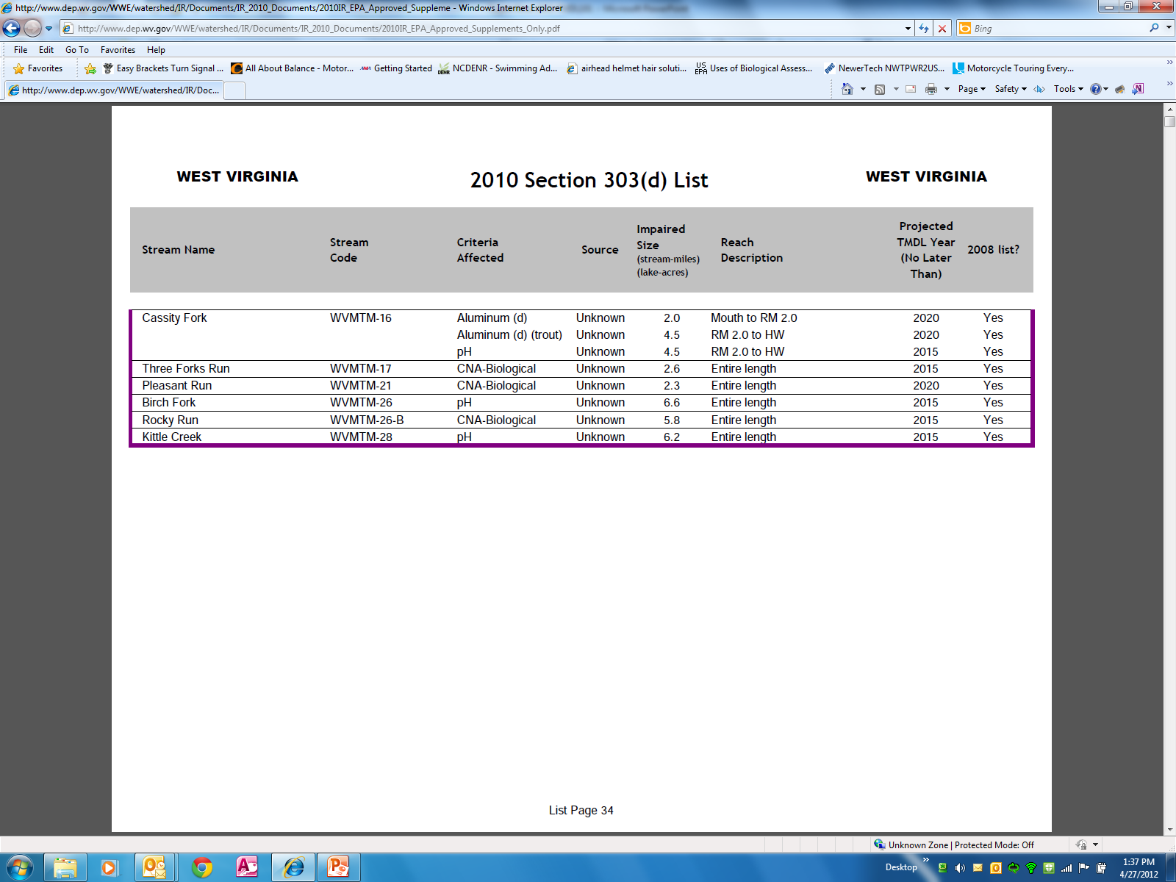

Slide 24
HG B3 TMDL Timeline
Stream selection
3/12 – 4/12
Monitoring plan development
3/12 - 5/12
Outreach (TMDL process + monitoring plan specifics)
5/12 – 6/12
Stream Monitoring and Source Tracking
7/12 – 6/13

Slide 25
HG B3 TMDL Timeline
Modeling
10/13 – 6/14
Outreach (Status Update)
7/14 - 9/14
Draft TMDLs (Internal Review)
3/15
Outreach (PN/PC on Drafts)
4/15 – 6/15

Slide 26
HG B3 TMDL Timeline
Finalization (including EPA approval) 12/15
Implementation begins
7/16 – NPDES Water Permits
1/17 – NPDES Mining Permits

Slide 27
Pre-TMDL Monitoring Plan
Goal – to generate robust/ recent data to:
Make accurate impairment assessments
Calibrate watershed models
Quantify the impacts of significant pollutant sources
Today’s presentation is a preliminary plan; to be refined via WVDEP field recon and stakeholder input

Slide 28
Pre-TMDL Monitoring Plan
Detailed map on DEP webpage
Impairments/potential impairments being evaluated:
Biological Integrity (bug collection for reevaluation of stream status)
Total Iron, Dissolved Aluminum, Total Manganese, pH
Fecal coliform bacteria
336 sites on 227 streams
GIS coverage available upon request

Slide 29
Legend
ACID RAIN
AMD
ACID RAIN/AMD
AMD/FECAL
ACID RAIN/AMD/FECAL
AMD/FECAL/BIO
ACID RAIN/AMD/FECAL/BIO
AMD/FECAL/Be/Se/BIO
ACID RAIN/AMD/FECAL/Be/Se/BIO
AMD/FECAL/ION/BIO
ACID RAIN/BIO
AMD/FECAL/ION/Be/Se
ACID RAIN/FECAL/BIO
AMD/FECAL/ION/Be/Se/BIO
ACID RAIN/SED
AMD/FECAL/ION/Be/Se/Mn/BIO
ACID RAIN/SED/BIO
AMD/FECAL/ION/Mn
ACID RAIN/SED/Be/Se
AMD/FECAL/ION/Mn/BIO
ACID RAIN/SED/FECAL
AMD/FECAL/Mn/BIO
ACID RAIN/SED/FECAL/BIO
AMD/FECAL/NUTRIENT/ION/BIO
ACID RAIN/SED/FECAL/Be/Se/BIO
AMD/FECAL/NUTRIENT/ION/Mn
AMD/FECAL/NUTRIENT/ION/Mn/BIO
SED/FECAL
CONTROL/BIO
SED/FECAL/BIO
CONTROL/PRS-BIO
SED/FECAL/ION/BIO
SED/FECAL/Mn/BIO
SED/FECAL/NUTRIENT
SED/FECAL/NUTRIENT/BIO

Slide 31
Notes:
Should explain sampling suite legend i.e what does “AMD” mean? Would be nice to include Whitman’s one pager showing parameters monitored in each suite.

Slide 32
Pre-TMDL Monitoring Plan
Monitoring period = July 2012 – June 2013
Sampling frequency
Water chemistry (monthly)
Flow measurement (selected locations, monthly)
Benthic macroinvertebrates (once in WVSCI Index period)
RBP habitat evaluations (once with benthic assessment)
Notes:
If asked about monthly chemistry parameters answer that it varies with the prescribed sampling suites (whitman’s one pager)
If asked why do TDS ions – answers are 1) document current conditions and 2)use in stressor ID for benthics

Slide 33
Source Tracking Efforts
Abandoned Mine Lands
Limits of POTW collection systems
AFOs, Livestock counts
Riparian zone condition
Unmapped road density
Qualitative assessment of sediment sources
Active Mining Point Source Info

Slide 34
Stakeholder Input
General comments regarding plan’s adequacy in addressing goals
Does the plan provide for monitoring of particularly bad or good streams that you know about?
Does the plan provide monitoring sufficient to characterize significant pollutant sources?
Do you have water quality data to contribute?

Slide 35
Future Input Opportunities
Public meeting to present TMDL status update
– Summer 2014
Public Meeting to present Draft TMDL and formal Public Notice/Public Comment
– Spring 2015

Slide 36
WVDEP Contact Information
Contact: Steve Young – Stephen.A.Young@wv.gov
Tele: (304) 926-0499 Ext 1042;
FAX: (304) 926-0496
601 57th Street SE, Charleston WV 25304
www.dep.wv.gov
Select Water and Waste Home
On left select Watershed Management, click on “ Total Maximum Daily Load”

Slide 37
Questions???

