Slide 1
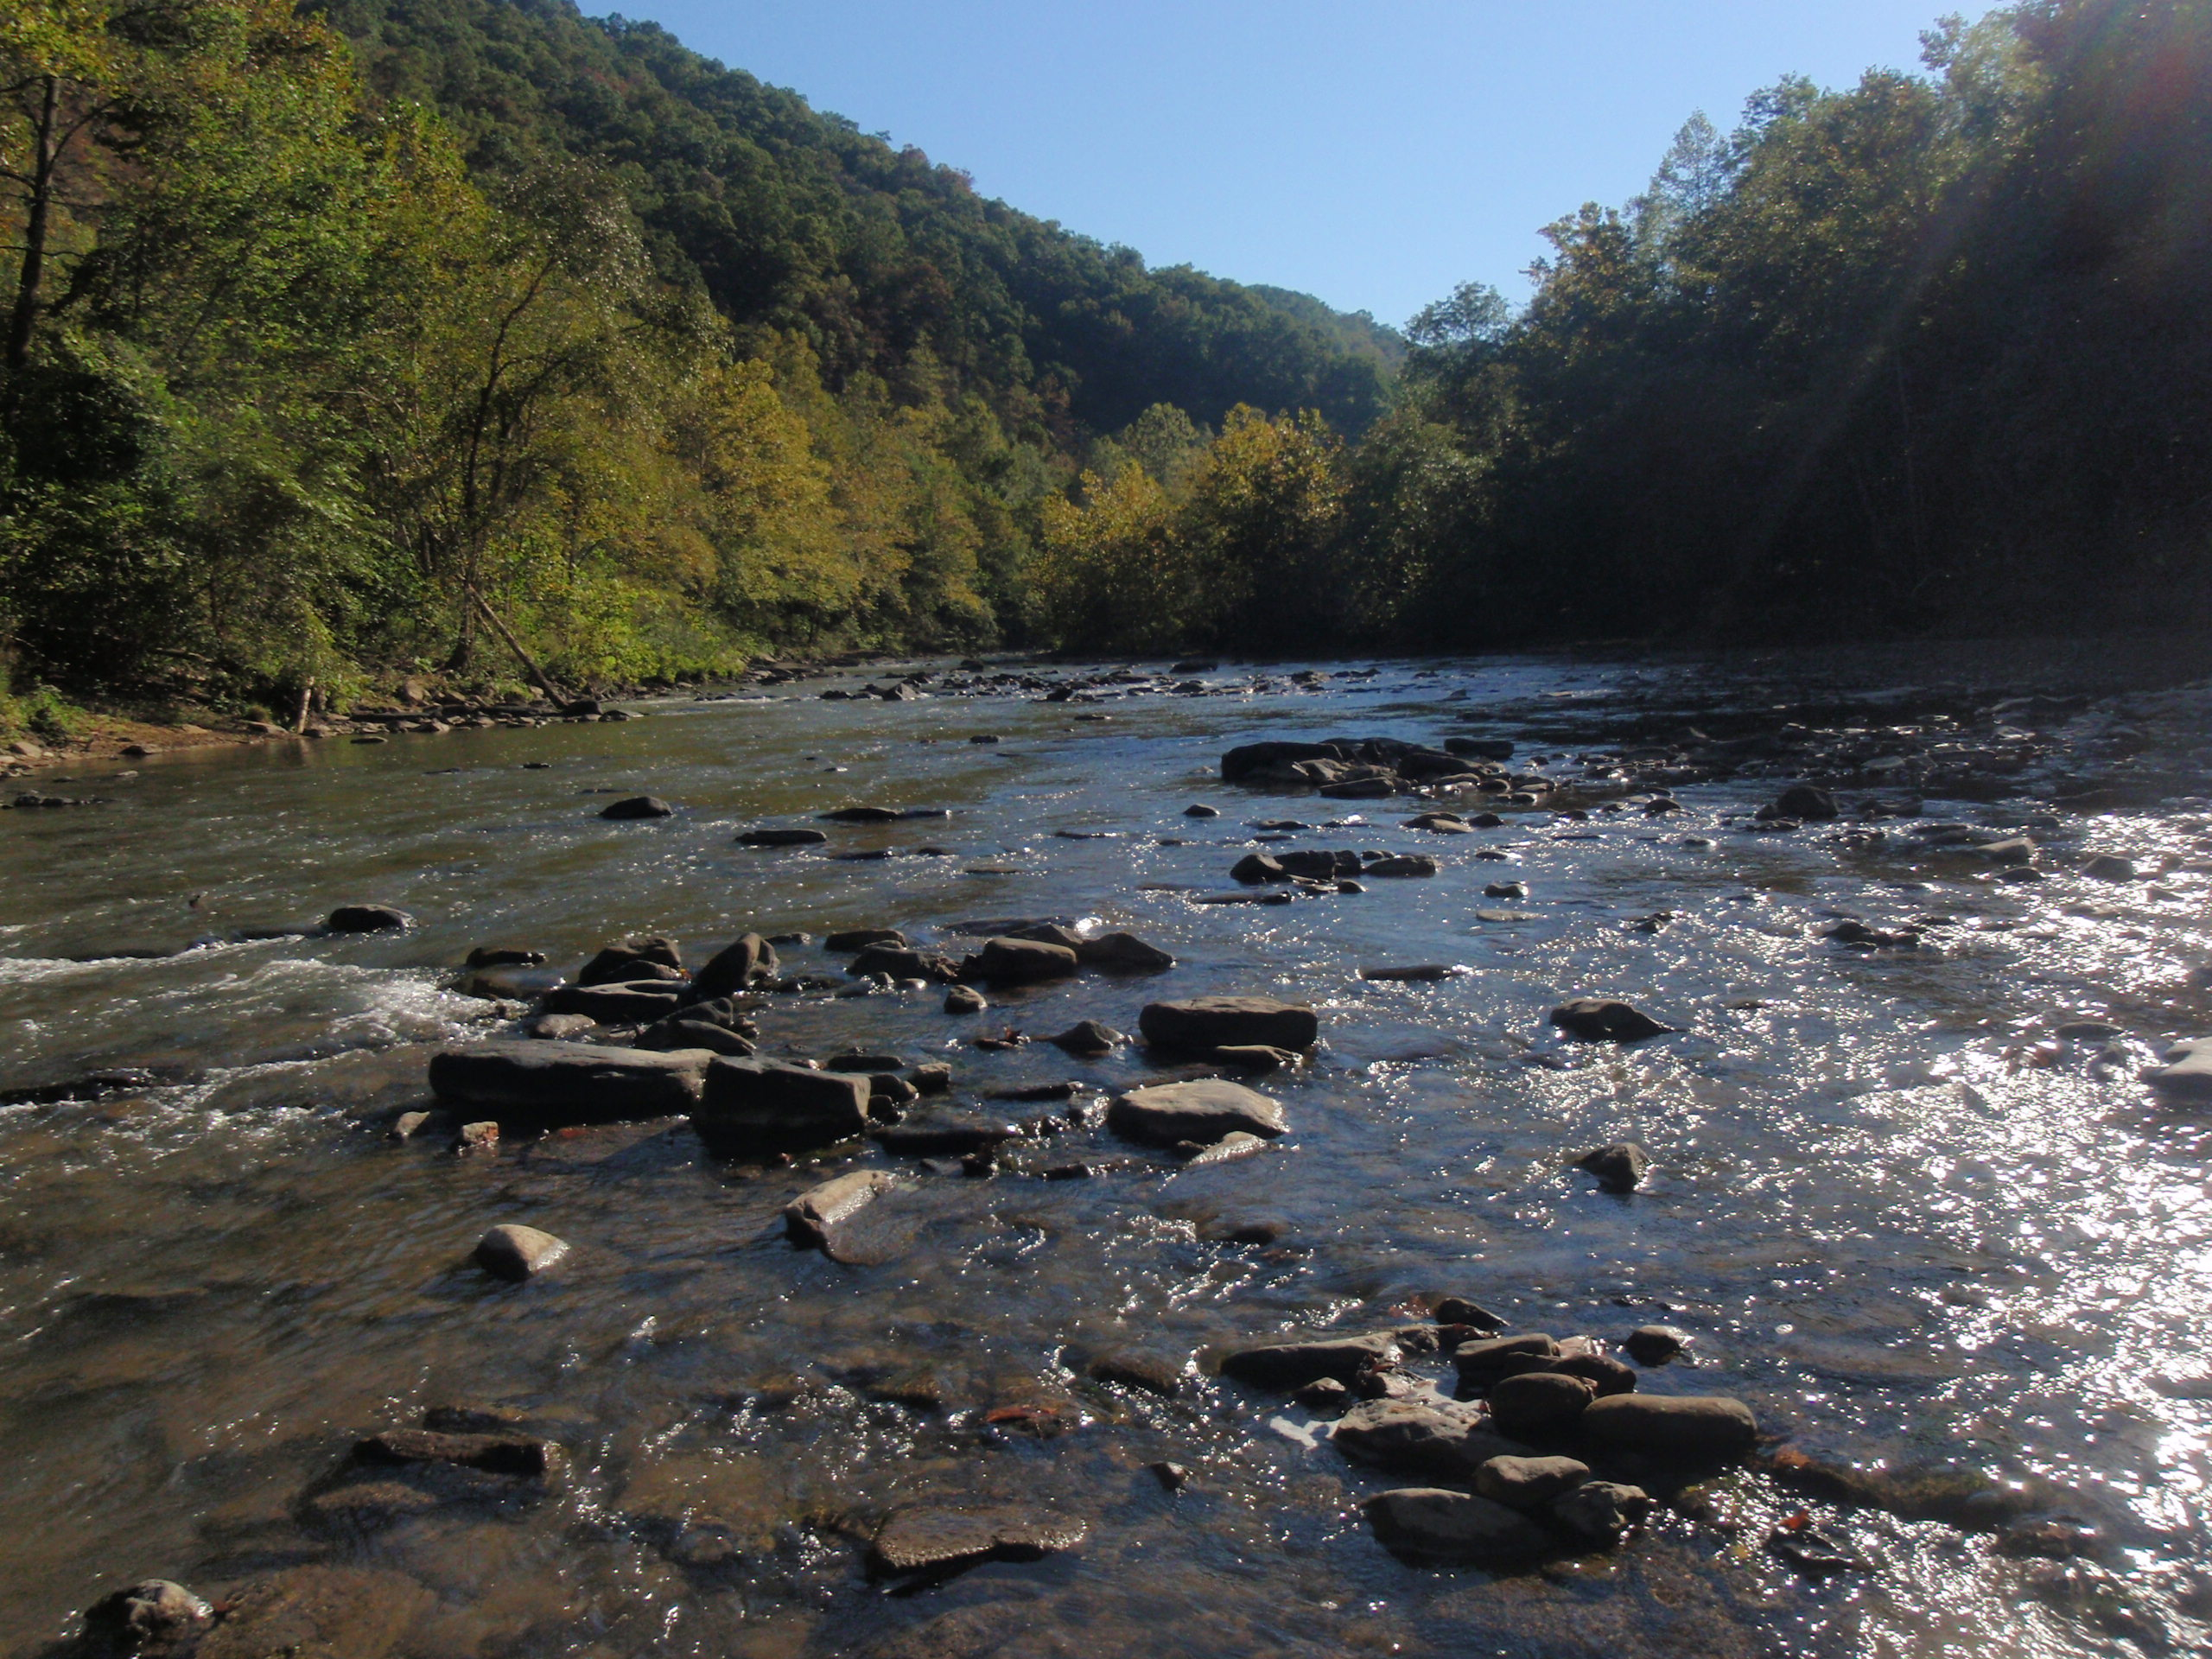
TMDL Development
Upper Guyandotte River Watershed
May 4th & 5th, 2015

Slide 2
Agenda
Background information on Water Quality Standards, impaired waters and TMDLs
Brief history of WV TMDL development
Overview of WVDEP’s TMDL process
Discussion of local impaired waters and their TMDL timeline
Pre-TMDL Monitoring Plan for local waters
Discussion – Free form questions and answers

Slide 3
What’s a TMDL?
“Total Maximum Daily Load” – How much of a pollutant/s a stream can receive and remain healthy
TMDL development is required by Clean Water Act for all impaired streams
TMDL is a pollutant budget – prescribes reduction in pollutants, where needed, that result in the restoration of an impaired stream

Slide 4
What’s an impaired stream?
Stream that doesn’t meet water quality standards
West Virginia Water Quality Standards are codified in 47 CSR 2
Standards include designated uses for WV waters and water quality criteria to protect those uses
Criteria can be numeric or narrative
Impaired streams (streams that are not meeting criteria) are on the 303(d) List

Slide 5

Numeric Criteria
  Fecal Coliform Bacteria
    Human Health Protection (Water Contact)
    200 counts/100ml as a monthly geometric mean
    No more than 10% of samples in a month exceed 400 counts/100ml
  Total Iron
  Human Health/Aquatic Life Protection
    1.5 mg/l as a 4 day average concentration (warmwater)
    1.0 mg/l as a 4 day average concentration (troutwater)
    Not to be exceeded more than once every 3 years
    Not to exceed 1.5 mg/l (Public Water)

Slide 6
Numeric Criteria continued
  Total Manganese
  Human Health
    Public Water - Not to exceed 1.0 mg/l
    Effective within a 5 mile zone above a public intake
  Dissolved Aluminum
  Aquatic Life
    750 ugl/l as a 1 hour or 4 day avg. concentration (warmwater)
    750 mg/l as a 1 hour avg. conenctration or 87 ug/l as a 4 day avg. concentration (troutwater)
    Not to be exceeded more than once every 3 years

Slide 7
Numeric Criteria continued
Selenium
  Aquatic Life/Public Drinking water
    Aquatic life criteria
      20 ug/l as a 1 hour average concentration
      5 ug/l as a 4 day average concentration
      Not to be exceeded more than once in three years
      Public Water - Not to exceed 50 ug/l
  pH
    Aquatic Life/Water Contact Recreation/Public Water Supply (All Uses)
      No values below 6.0 nor above 9.0.

Slide 8

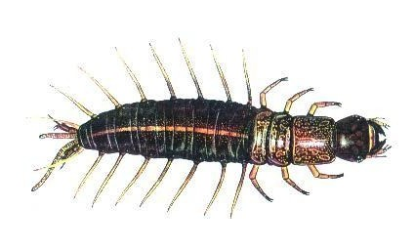
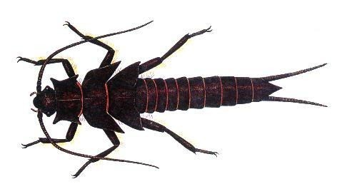
Narrative Criteria
Biological Impairment
  Conditions Not Allowable in State Waters
  (47 CSR 2-3.2i) “.....no significant adverse impact to the chemical, physical, hydrologic or biological components of aquatic ecosystems shall be allowed.”

Slide 9
Previous 47 CSR 2 - 3.2.i Assessment
Based on Benthic Macroinvertebrates
West Virginia Stream Condition Index (WVSCI)
  Standardized method for assessing benthic macroinvertebrates (aquatic bugs)
  WVSCI stream scores normalized to 0 - 100 range
  Streams scoring less than the 60.6 threshold value labeled as “impaired” and placed on the 303(d) list
  Streams listed as impaired slated for TMDLs
  “Biologically Impaired” streams evaluated for source/s of impairment during the TMDL development process (Stressor Identification Process)

Slide 10
2012 Legislative Changes
Senate Bill 562 passed by the 2012 West Virginia Legislature amended the WV Water Pollution Control Act
Requires “evaluation of the holistic health of the aquatic ecosystem”
Requires DEP to develop and secure legislative approval of new rules to interpret 47 CSR 2-3.2.i
http://www.legis.state.wv.us/wvcode/ChapterEntire.cfm?chap=22&art=11
Notes:
Web link is cumbersome – may want to have a dozen or so copies to hand out

Slide 11
Biological Impairment Path Forward
WV Draft 2012 303(d) List contained no new bio listings
WV Draft 2014 303(d) List added streams scoring less than 68.0 based upon EPA additions to the Final approved 2012 303(d) List
DEP currently working to develop a methodology which meets the legislative requirements set forth in SB562; considering incorporation of fish assessments

Slide 12
Biological Impairment Path Forward continued
No new WV developed TMDLs until new methodology becomes effective
Will continue benthic monitoring in interim
  Likely to remain a component of new method
  May be able to address existing 303(d) listings if stream no longer impaired per WVSCI or if WVSCI stressors can be resolved by attainment of numeric criterion

Slide 13
WVDEP TMDL Process
Stream Selection
Pre-TMDL monitoring, source identification and characterization
Contract to model water quality and hydrology
Allocation process
Draft Report development
Finalization including EPA approval

Slide 14
Process Highlights
Synchronized with WV Watershed Management Framework
48 month process (Stream selection – EPA approval)
Multiple opportunities for public outreach/ stakeholder input
Pre-TMDL water quality monitoring
Source identification and characterization

Slide 15
TMDL Stream Selection Process
Spread development over State
Evaluate list of impaired waters
Consider WMF
Maximize efficiency
  focus geographically
  address all known or suspected impairments
Resources

Slide 16
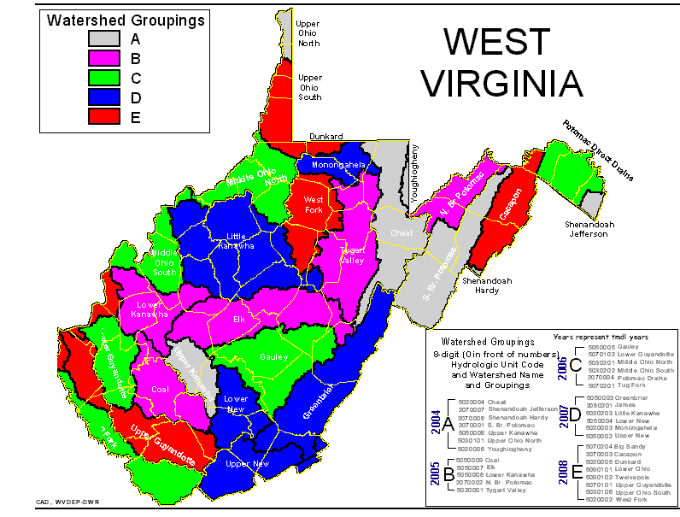
TMDL Development Stream Selection Process
Watershed Management Framework Consideration
TMDL Development Hydrologic Group E3
Within HG E3 candidate watersheds = Big Sandy, Cacapon, Dunkard, Lower Ohio, Twelvepole, Upper Guyandotte, Upper Ohio South, West Fork

Slide 17
TMDL Stream Selection Process
DEP advertised proposal of Upper Guyandotte River TMDL development & provided opportunity for public comment (March 5th - April 6th), No Comments received.
Upper Guyandotte River watershed (above Logan) selected for TMDL development, effort includes re-evaluation of previous EPA TMDLs [standards changes – Fe (tr), Al (wm), Mn].
Due to resource constraints, a PCB TMDL for R.D. Bailey Lake is not proposed as part of this project.
TMDLs will be developed for any new impairments identified in pre-TMDL monitoring (with possible exception of Bio Impairment)

Slide 18
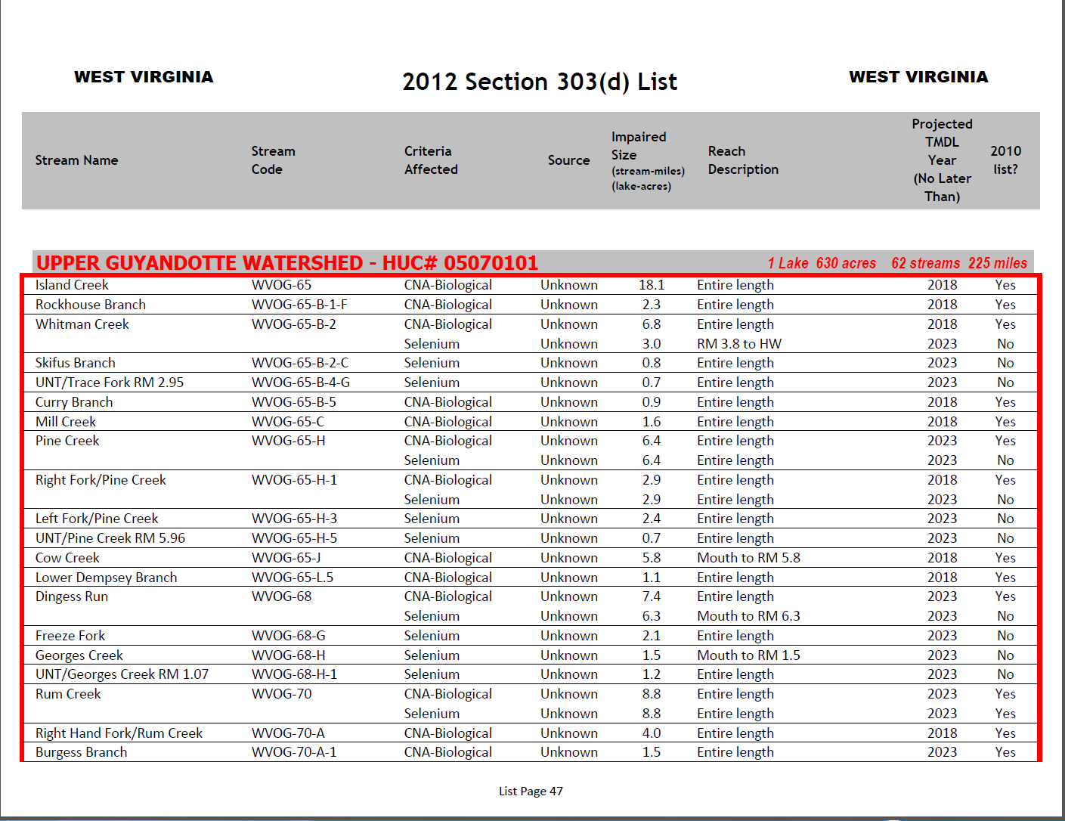

Slide 19
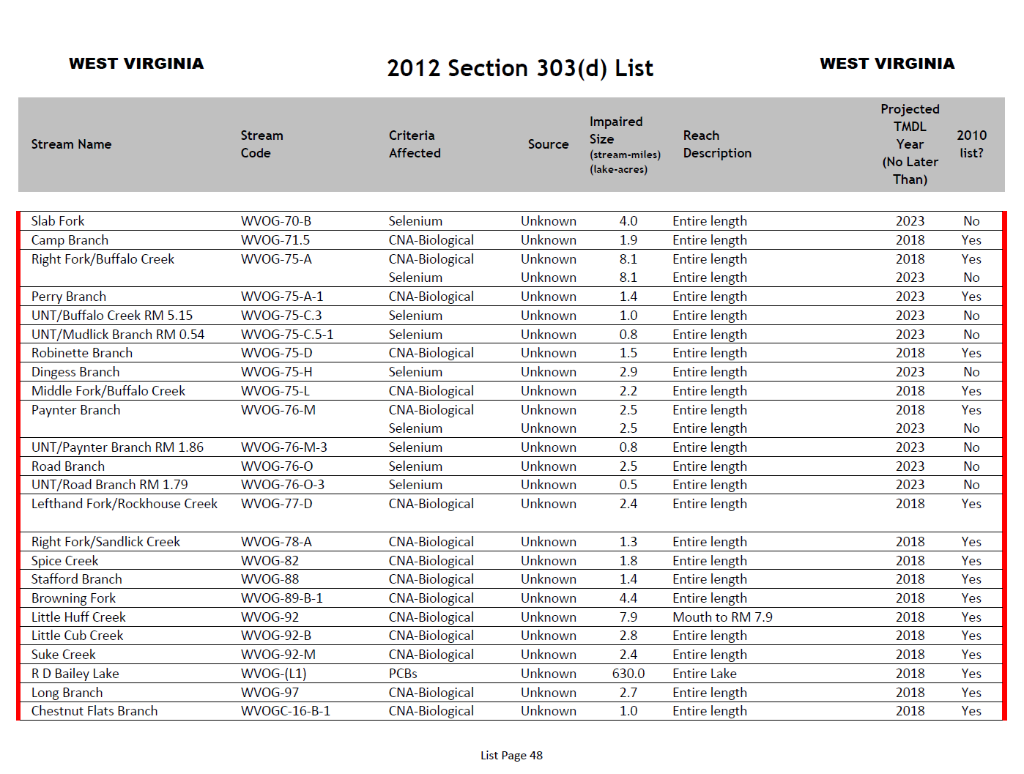

Slide 20
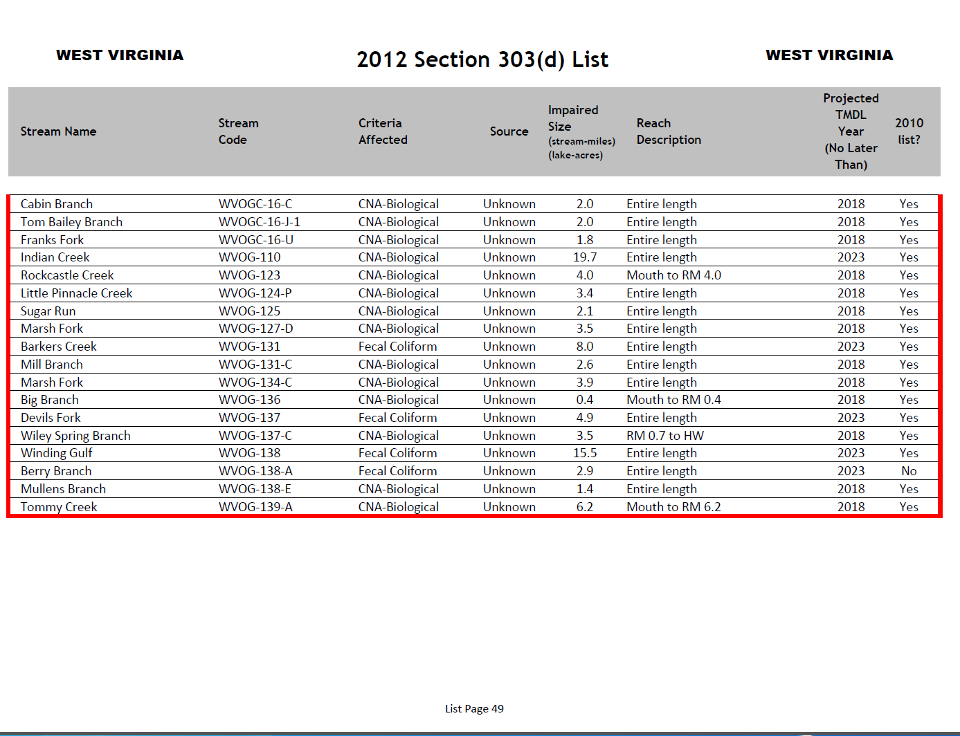
Previous EPA TMDLs are listed in Appendix B of 303d List

Slide 21
HG E3 TMDL Timeline
Stream selection
3/5 – 4/6
Monitoring plan development
3/5 - 4/13
Outreach (TMDL process + monitoring plan specifics)
4/20 – 5/20
Stream Monitoring and Source Tracking
7/2015 – 6/2016

Slide 22
HG E3 TMDL Timeline
Modeling
10/2016 – 3/2018
Outreach (Status Update)
7/2017 - 9/2017
Draft TMDLs (Internal Review)
3/2018
Outreach (PN/PC on Drafts)
4/2018 – 6/2018

Slide 23
HG E3 TMDL Timeline
Finalization (including EPA approval) 12/2018
Implementation begins
7/2019 – NPDES Water Permits
1/2020 – NPDES Mining Permits

Slide 24
Pre-TMDL Monitoring Plan
Goal – to generate robust/ recent data to:
  Make accurate impairment assessments
  Calibrate watershed models
  Quantify the impacts of significant pollutant sources
Today’s presentation is a preliminary plan; to be refined via WVDEP field recon and stakeholder input

Slide 25
Pre-TMDL Monitoring Plan
Monitoring period = July 2015 – June 2016
Sampling frequency
  Water chemistry (monthly) & selected parameters (quarterly)
  Flow measurement (selected locations, monthly)
  Benthic macroinvertebrates (once in WVSCI Index period)
  RBP habitat evaluations (once with benthic assessment)
Notes:
If asked about monthly chemistry parameters answer that it varies with the prescribed sampling suites (whitman’s one pager)
If asked why do TDS ions – answers are 1) document current conditions and 2)use in stressor ID for benthics

Slide 26
Pre-TMDL Monitoring Plan
Sample site map on DEP webpage - GIS available
Impairment/potential impairment sampling suites:
Sed – TSS, T. & Dis. Iron
Fecal - fecal coliform
  Se – T. Selenium
  Mn – T. Manganese
  AMD – Hot Acidity, Alkalinity, TDS, TSS, Ammonia*, T. & Dis. Al, T & Dis. Iron, Mg, Ca, (Sulfate, Chloride, K and Na – quarterly)
  Bio (Bugs &/or Fish) Once during applicable season to evaluate current stream status
  311 sites on 199 streams

Slide 27
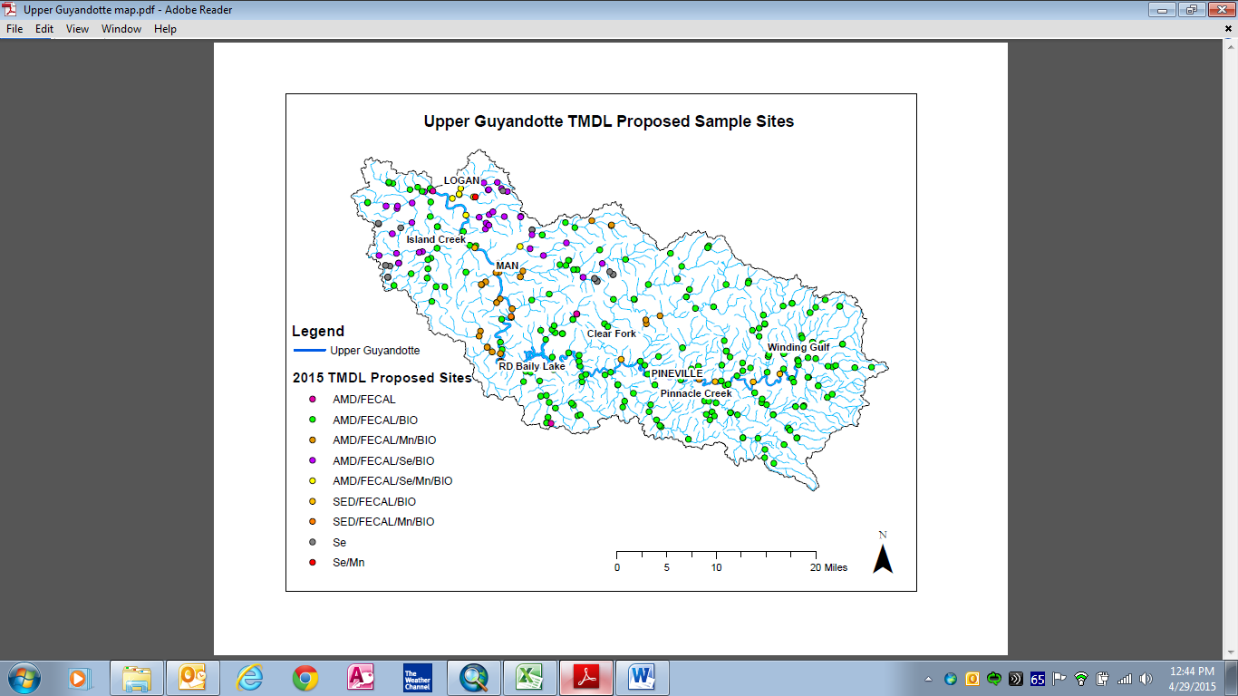
  311 sites on 199 streams

Slide 28
Source Tracking Efforts
Abandoned Mine Lands
Limits of POTW collection systems
Assessment of failing onsite systems
AFOs, Livestock counts, livestock stream access
Riparian zone condition
Unmapped road density
Qualitative assessment of sediment sources
Active Mining Point Source Info

Slide 29
Stakeholder Input
General comments regarding plan’s adequacy in addressing goals
Does the plan provide for monitoring of particularly bad or good streams that you know about?
Does the plan provide monitoring sufficient to characterize significant pollutant sources?
Do you have water quality data to contribute?

Slide 30
Future Input Opportunities
Public meeting to present TMDL status update
– Summer 2017
Public Meeting to present Draft TMDL and formal Public Notice/Public Comment
– Summer 2018

Slide 31
WVDEP Contact Information
Contact: Steve Young – Stephen.A.Young@wv.gov
Tele: (304) 926-0499 Ext 1042;
FAX: (304) 926-0496
601 57th Street SE, Charleston WV 25304
www.dep.wv.gov
  Select Water and Waste Home
  On left select Watershed Management, click on
  “ Total Maximum Daily Load”

Slide 32
Questions???

