Slide 1
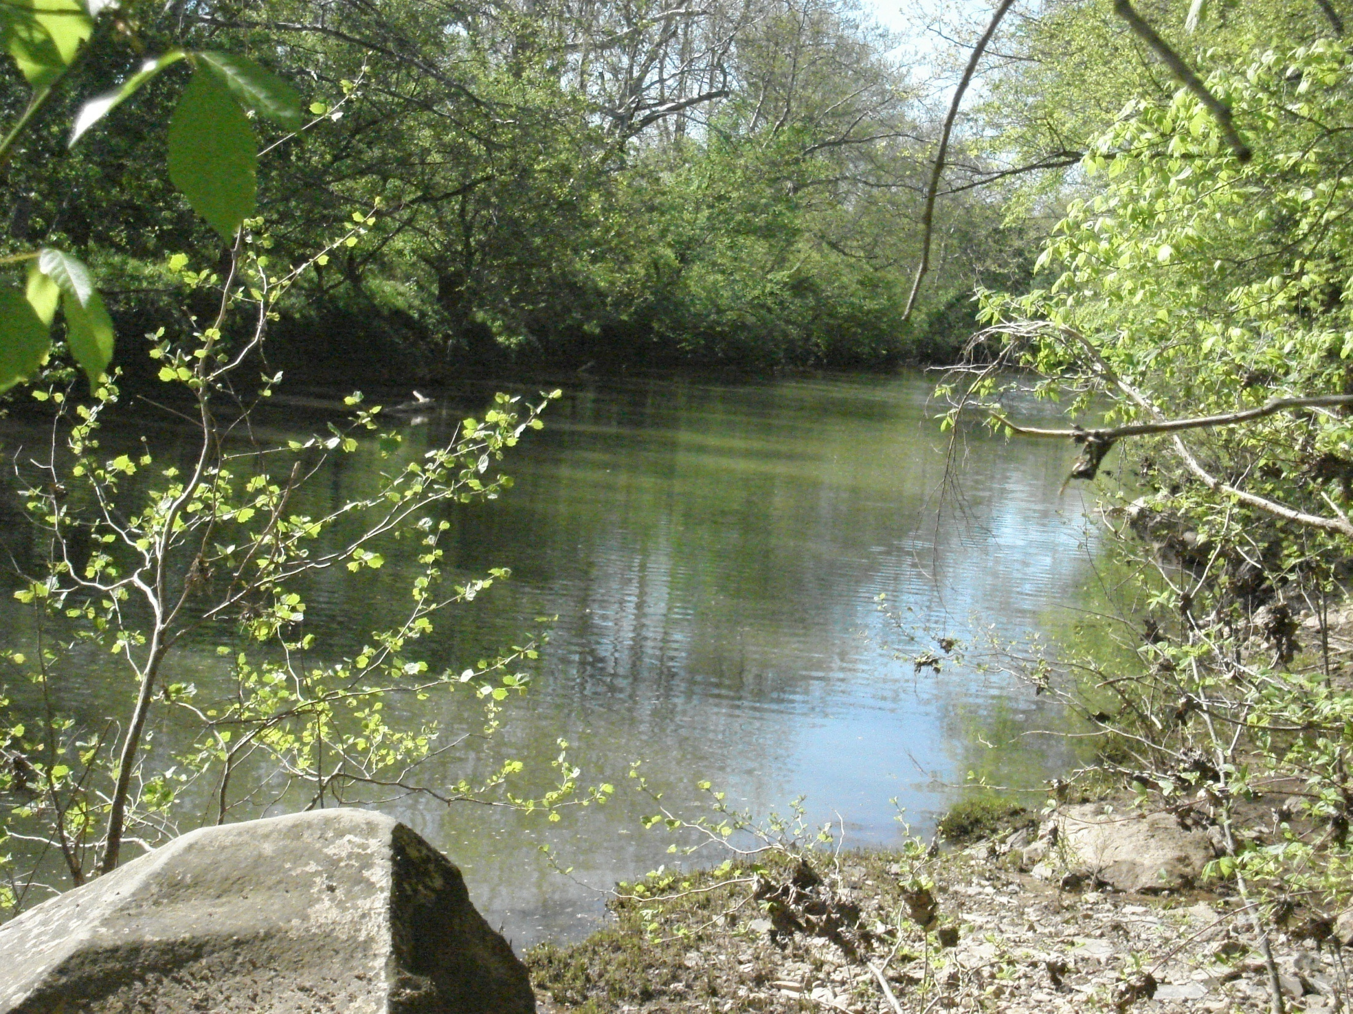
TMDL Development
West Fork River Watershed
July 27th, 2010
WV DEP
James Laine

Slide 2
Agenda
Background information on Water Quality Standards, impaired waters and TMDLs
Brief history of WV TMDL development
Overview of WVDEP’s TMDL process
Discussion of local impaired waters and their TMDL timeline
Pre-TMDL Monitoring Plan for local waters
Discussion – Free form questions and answers

Slide 3
What’s a TMDL?
“Total Maximum Daily Load” – How much pollutant a stream can receive and remain healthy
TMDL development is required by Clean Water Act for all impaired streams
TMDL is a pollution budget – prescribes reduction of pollutants that result in the restoration of an impaired stream

Slide 4
What’s an impaired stream?
Stream that doesn’t meet water quality standards
West Virginia Water Quality Standards are codified at 47 CSR 2
Standards include designated uses for WV waters and water quality criteria to protect those uses
Criteria can be numeric or narrative
Impaired streams (streams that are not meeting criteria) are on the 303(d) List

Slide 5
Criteria Examples
Human Health Protection
  Fecal Coliform bacteria (Water Contact)
    200 counts/100ml as a monthly geometric mean
    no more than 10% of samples in a month exceed 400 counts/100ml
Human Health/Aquatic Life Protection
  Total Iron
    1.5 mg/l as a 4 day average concentration
    Not to be exceeded more than once every 3 years

Slide 6
Criteria Examples
Human Health/Aquatic Life Protection
  Chlorides
    230 mg/l (Aquatic Life)
    250 mg/l (Human Health) salty taste
Aquatic Life
  Dissolved Aluminum
    750 ugl/l as a 4 day average concentration
    Not to be exceeded more than once every 3 years

Slide 7

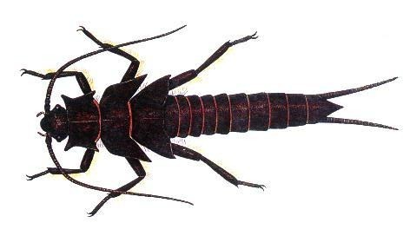
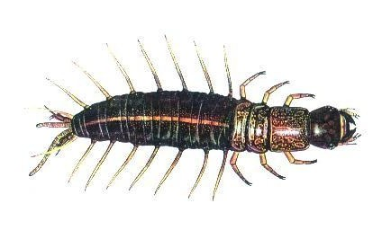
Criteria Examples
Biological Impairment
  Conditions Not Allowable in State Waters
  (47 CSR 2-3.2i) “.....no significant adverse impact to the chemical, physical, hydrologic or biological components of aquatic ecosystems shall be allowed.”
  Benthic macroinvertebrate assessment
  West Virginia Stream Condition Index (WVSCI)

Slide 8
Criteria Examples
West Virginia Stream Condition Index (WVSCI)
  Standardized method for assessing benthic macroinvertebrates (aquatic bugs)
  WVSCI stream scores are normalized to 0 - 100 range
  Streams scoring less than the 60.6 threshold value are labeled as “impaired” and placed on the 303(d) list
  Streams listed as impaired are then slated for TMDL development
  “Biologically Impaired” streams are evaluated for source/s of impairment during the TMDL development process (Stressor Identification Process)

Slide 9
West Virginia TMDL History
TMDL development required by Clean Water Act for all impaired streams
If State doesn’t develop TMDLs, EPA must
WV couldn’t (resources), EPA didn’t
EPA was sued in 1995, settled suit by entering into consent decree with plaintiffs, and began developing WV TMDLs
In 2004, WV finalized its first group of TMDLs developed under state direction

Slide 10
WVDEP TMDL Process
Stream Selection
Pre-TMDL monitoring, source identification and characterization
Contract to model water quality and hydrology
Allocation
Report development
Finalization

Slide 11
Process Highlights
Synchronized with WV Watershed Management Framework
48 month process (Stream selection– EPA approval)
Multiple opportunities for public outreach/stakeholder input
Pre-TMDL water quality monitoring
Source identification and characterization

Slide 12
TMDL Stream Selection Process
Spread development over State
Evaluate list of impaired waters
Consider WMF
Maximize efficiency
  focus geographically
  address all known or suspected impairments
Resources

Slide 13
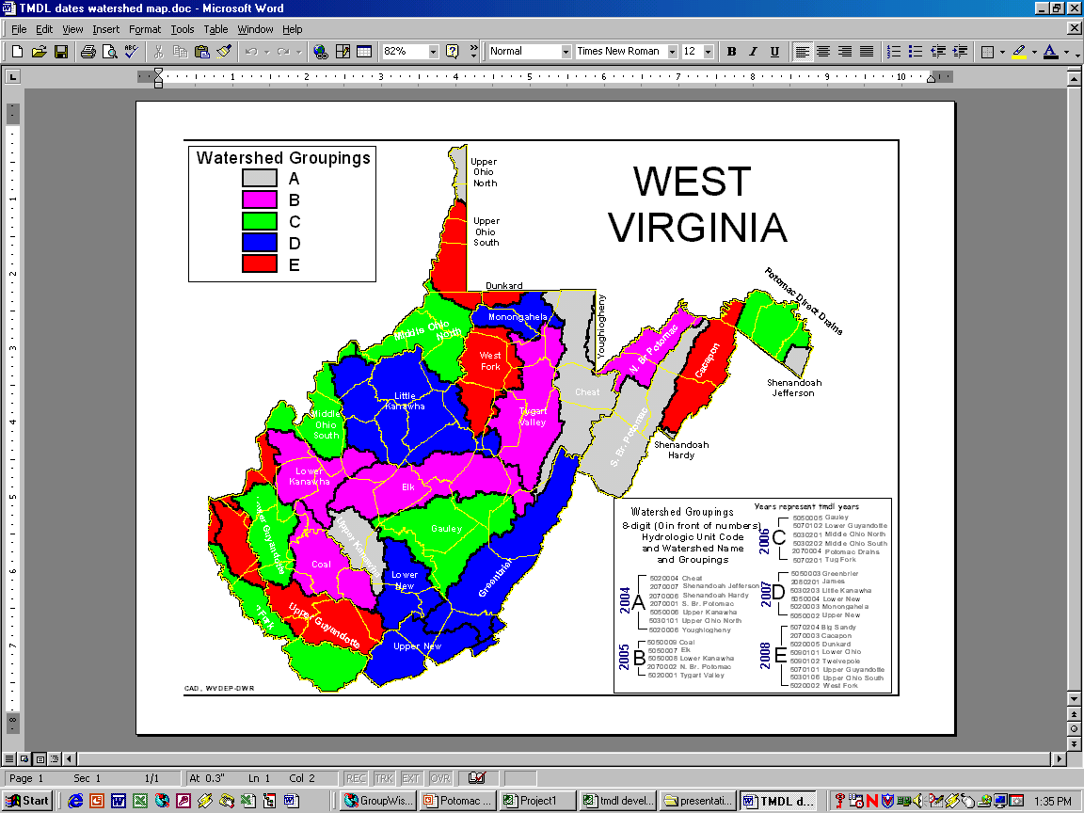
Watershed Management Framework
32 watersheds (8-digit HUC)
5 Hydrologic Groups (A – E)
Geographical way to organize water resource management – Within DEP, watershed assessment, NPDES Permit reissuance and nonpoint source project funding synchronized
WVDEP TMDL development synchronized

Slide 14
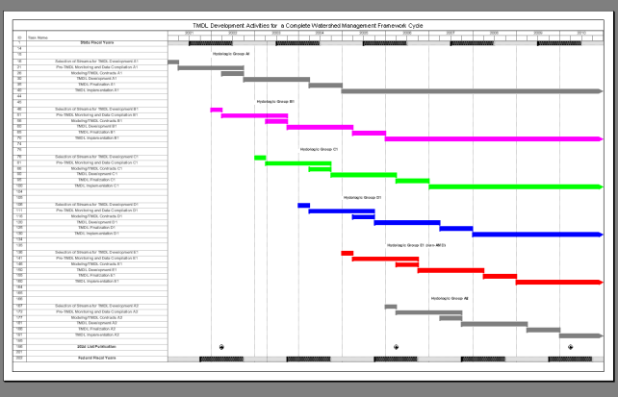
TMDL/WMF Synchronization
Pre-TMDL monitoring occurs concurrently with WMF assessment year
TMDL completion six months prior to start of WMF implementation year
5yr WMF cycle/15 year plan
3 bites at each HG apple

Slide 15
TMDL Development Stream Selection Process
Watershed Management Framework Consideration
TMDL Development Hydrologic Group E2
Within HG E₂, candidate watersheds = Big Sandy, Cacapon, Dunkard, Lower Ohio, Twelvepole, Upper Guyandotte, Upper Ohio South and West Fork

Slide 16
TMDL Development Stream Selection Process
Statewide Coverage Considerations
  TMDL development has occurred in Cacapon, Dunkard, Lower Ohio, Twelvepole, Upper Guyandotte and Upper Ohio South watersheds.
  Older, EPA-developed TMDLs exist for the West Fork watershed; revision required due to significant changes in aluminum and manganese water quality standards

Slide 17
TMDL Development Stream
Selection Process
DEP proposed TMDLs for dissolved aluminum, total iron, total manganese, fecal coliform bacteria, pH and biological impairments of the West Fork River and tributaries
DEP advertised proposal and provided opportunity for comment (March 23 – April 30, 2010) - No Comments received
Final selection – West Fork River and tributaries from headwaters to its confluence with the Tygart River

Slide 18
TMDL Development Stream
Selection Process
Due to the technical knowledge required and current resource constraints, TMDLs for PCBs and Hg are not proposed as part of this effort
Draft 2010 Integrated Report proposes delisting of West Fork River for Zn based on the Spelter remediation project and recent water quality data

Slide 19
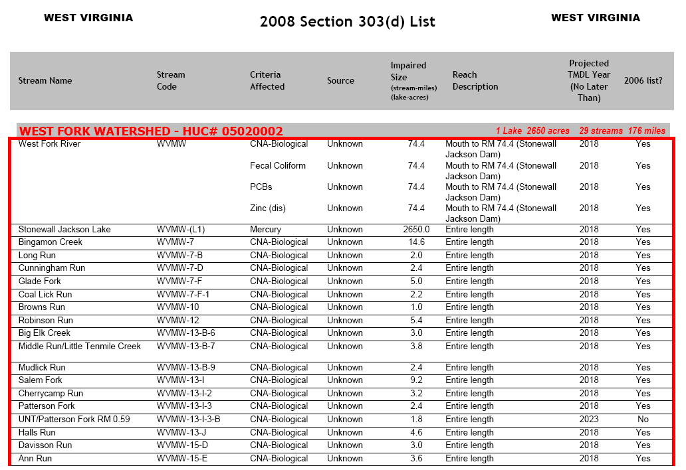
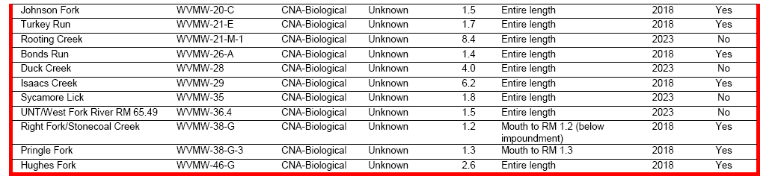

Slide 20
HG E2 TMDL Timeline
Stream selection
3/10 – 4/10
Monitoring plan development
3/10 - 6/10
Outreach (TMDL process + monitoring plan specifics)
7/10 – 8/10
Stream Monitoring and Source Tracking
7/10 – 6/11

Slide 21
HG E2 TMDL Timeline
Modeling
10/11 – 6/12
Outreach (Allocation scenarios)
7/12 - 9/12
Draft TMDLs (Internal Review)
3/13
Outreach (PN/PC on Drafts)
4/13 – 6/13

Slide 22
HG E2 TMDL Timeline
Finalization (including EPA approval) 12/13
Implementation begins
7/14 – NPDES Water Permits
1/15 – NPDES Mining Permits

Slide 23
Pre-TMDL Monitoring Plan
Goal – to generate robust/ recent data to:
  Make accurate impairment assessments
  Calibrate watershed models
  Quantify the impacts of significant pollutant sources
Today’s presentation is a preliminary plan; to be refined via WVDEP field recon and stakeholder input

Slide 24
Pre-TMDL Monitoring Plan
See handouts – detailed map on DEP webpage
Impairments/potential impairments being evaluated:
  Biological Integrity
  Total Iron, Dissolved Aluminum, Total Manganese, pH
  Fecal coliform bacteria
  301 sites on 244 streams
GIS coverage available upon request

Slide 25
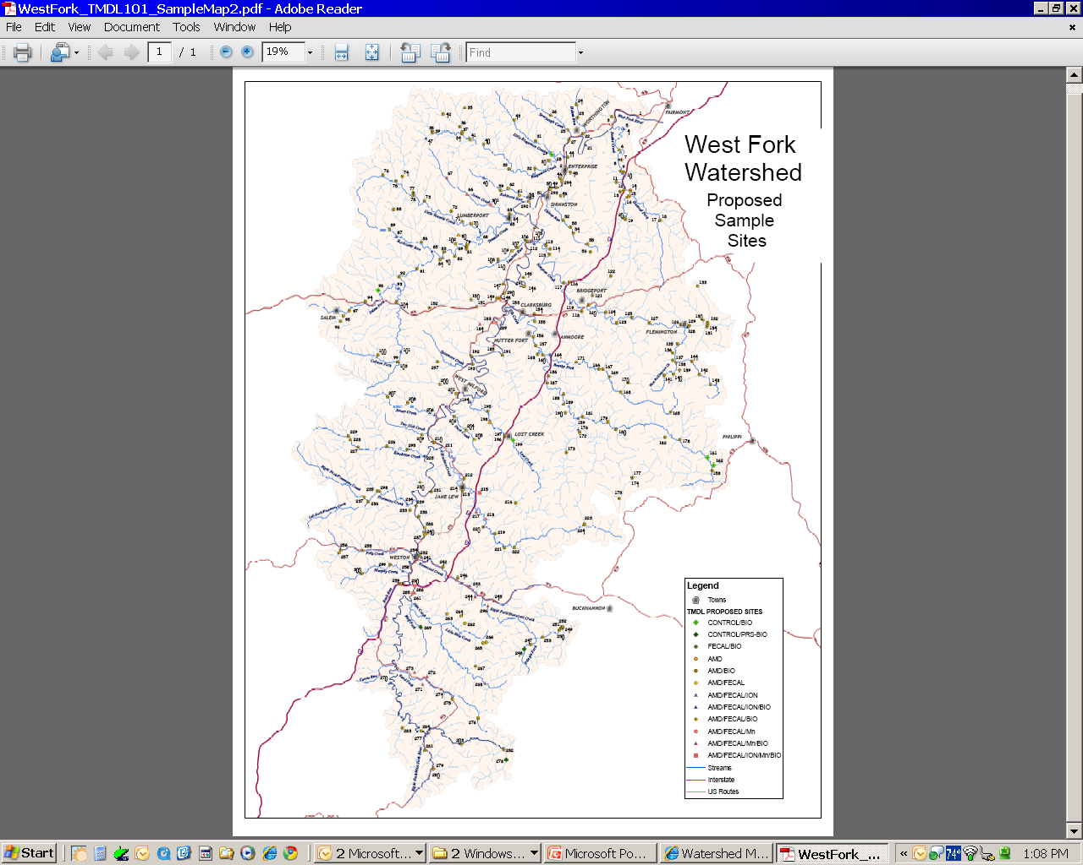

Slide 26
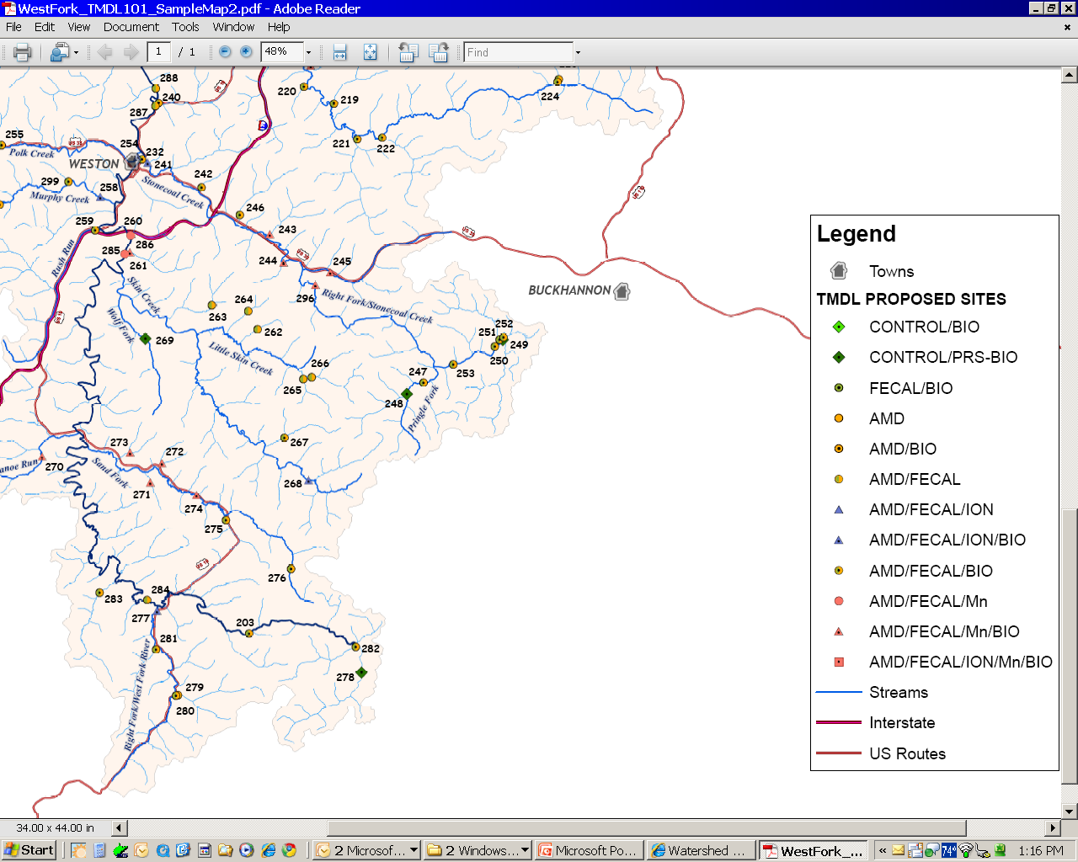

Slide 27
Pre-TMDL Monitoring Plan
Monitoring period = July 10 – June 11
Sampling frequency
  Benthic macroinvertebrates - during index period (Apr – Oct)
  Habitat evaluations (RBP)
  1/Month for water chemistry parameters
  pH, D.O., Specific Conductance, Temp.
  Sampling will include flow measurement at select locations

Slide 28
Total Dissolved Solids & constituent ions
Recent concern of elevated levels in Monongahela River watershed
Efficiencies gained by sampling as part of an ongoing effort rather than separate effort
Data collected could be useful to Pennsylvania’s efforts on TDS and stressor identification process for biologically impaired streams
Primary Goal is collection of data to document current conditions
Continuous monitors for pH and conductivity to be placed at select locations within the watershed

Slide 29
Source Tracking Efforts
Abandoned Mine Lands
Limits of POTW collection systems
AFOs, Livestock counts
Riparian zone condition
Unmapped road density
Qualitative assessment of sediment sources
Active Mining Point Source Info

Slide 30
Stakeholder Input
General comments regarding plan’s adequacy in addressing goals
Does the plan provide for monitoring of particularly bad or good streams that you know about?
Does the plan provide monitoring sufficient to characterize significant pollutant sources?
Do you have water quality data to contribute?

Slide 31
Future Input Opportunities
Public meeting to present allocation scenarios
– Summer 2012
Public Meeting to present Draft TMDL and formal Public Notice/Public Comment
– Spring 2013

Slide 32
WVDEP Contact Information
Contact: Steve Young – Stephen.A.Young@wv.gov
Tele: (304) 926-0499 Ext 1042;
FAX: (304) 926-0496
601 57th Street SE, Charleston WV 25304
www.wvdep.org
  Select Water and Waste Home
  On left select Watershed Management, click on “ Total Maximum Daily Load”

Slide 33
Questions???

