Slide 1
Industry Training
NPDES
Session 1
Permitting Issues
April 17. 2018

Slide 2
Bean Count

Slide 3
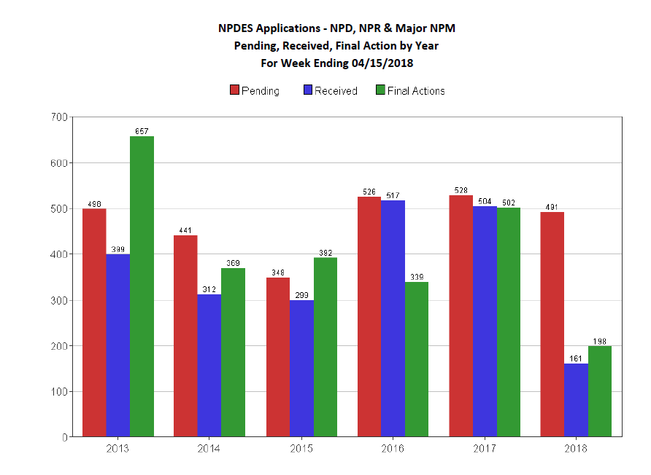

Slide 4
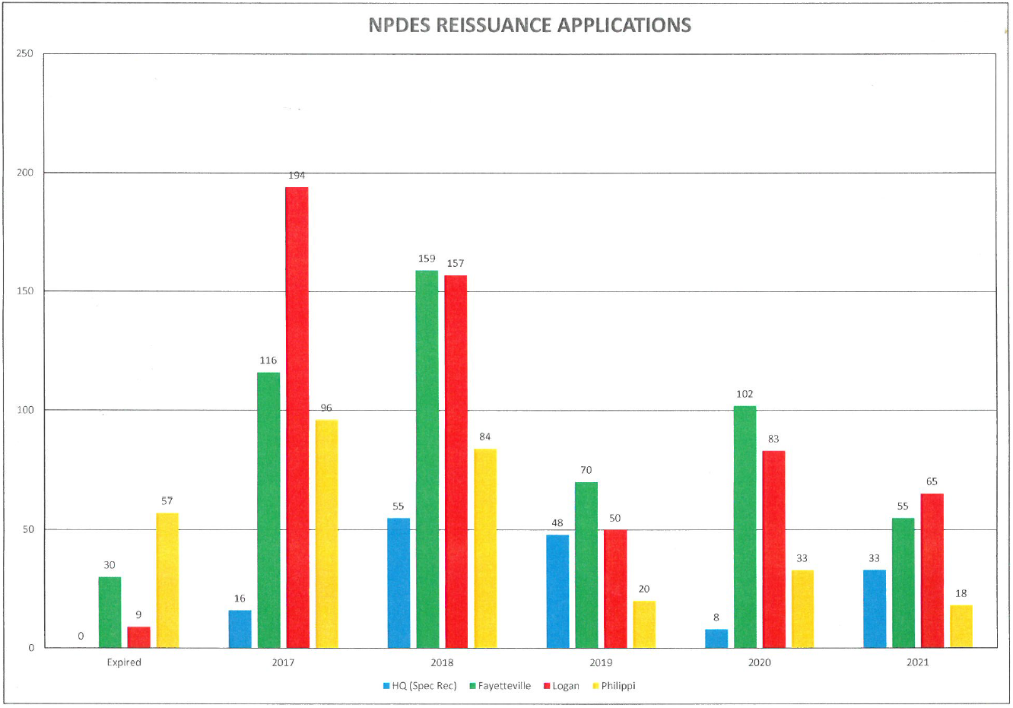

Slide 5
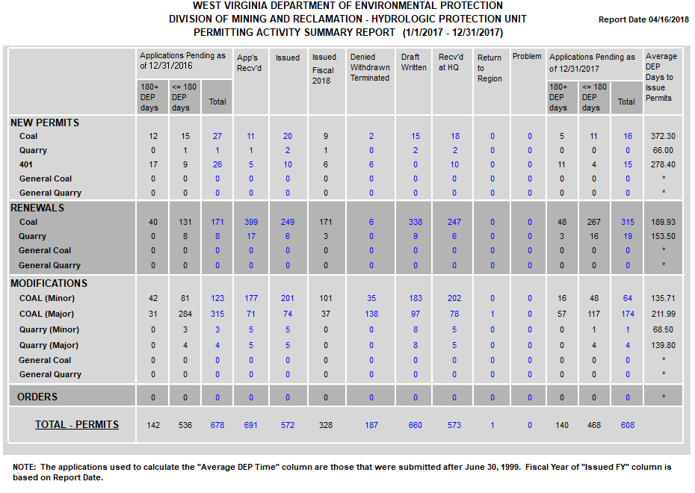

Slide 6
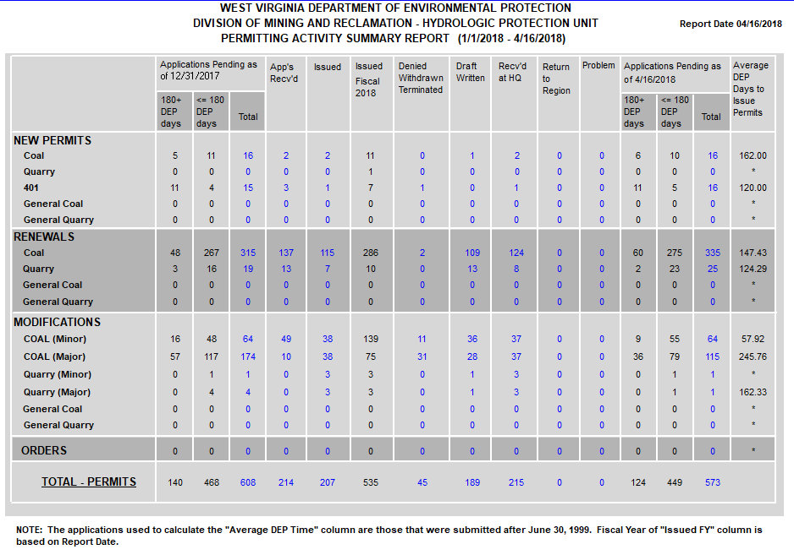

Slide 7
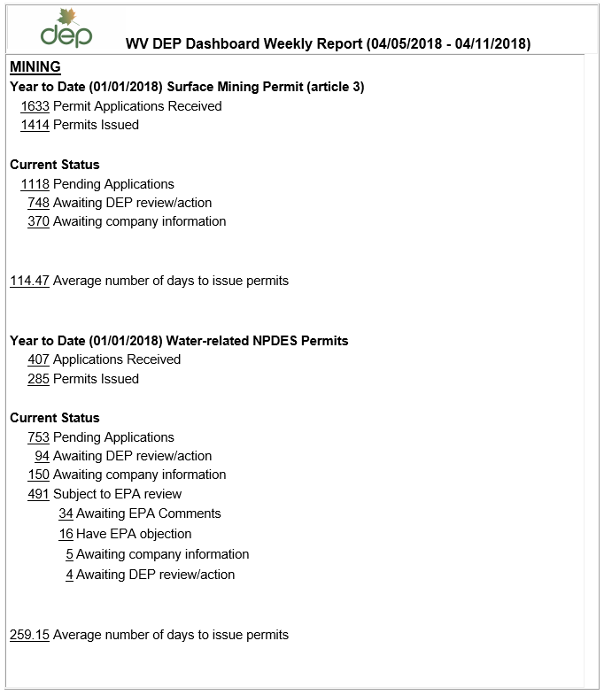

Slide 8
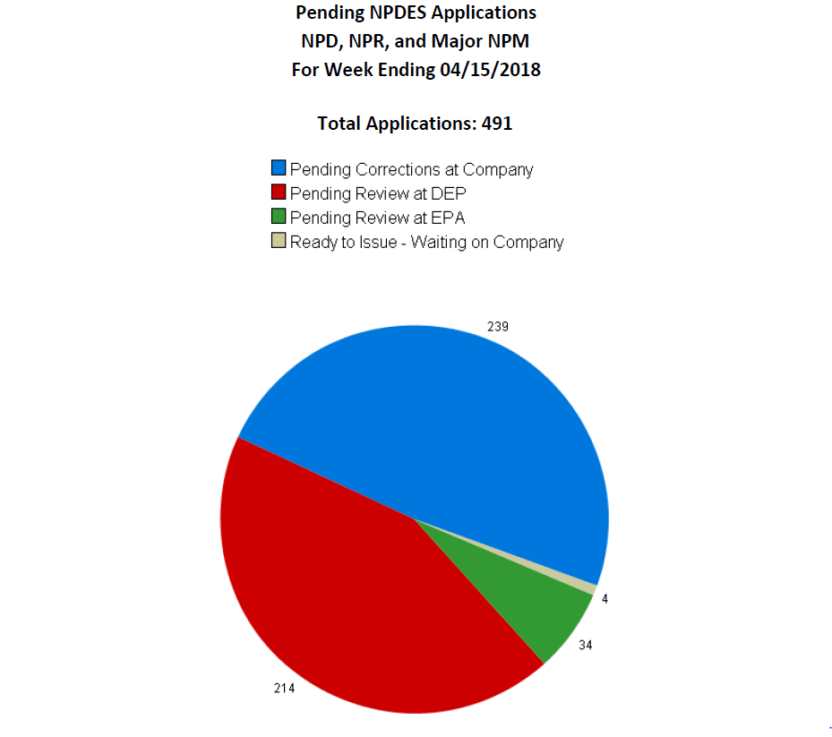

Slide 9
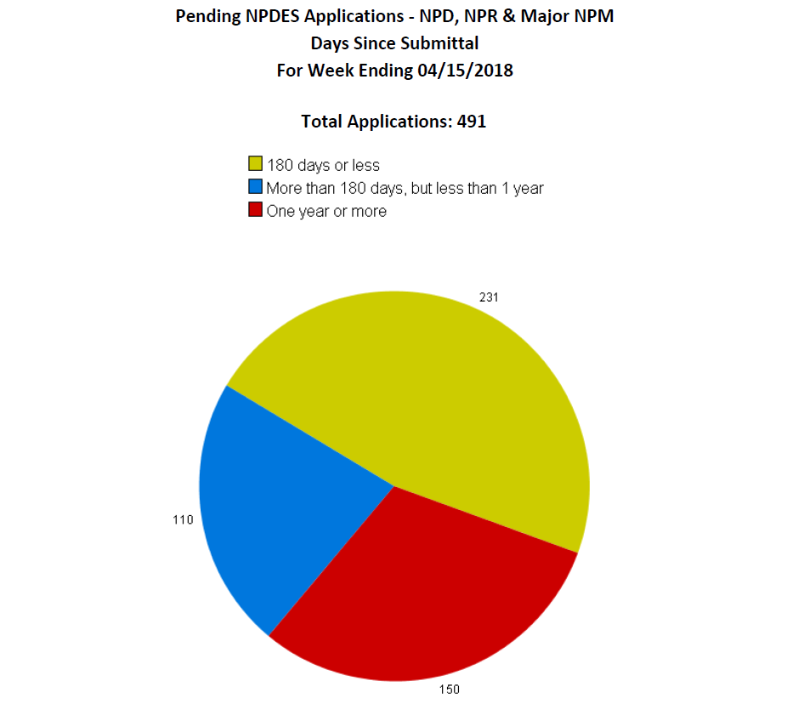

Slide 10
NPDES Application Administrative Review Effective March 6, 2013

Slide 11
Objectives:
Assure completeness of applications
Promote regional consistency
Expedite review process
Help prevent backlog

Slide 12
Gatekeeping a Submittal
DEP will conduct the Administrative Review once the e-application is gatekept.
Items necessary to allow the application to be gatekept must be included up-front:
- Filling Fee
$1000 for a new permit
$1000 for a reissuance
$500 for a modification
Signature Certification
Drainage Map

Slide 13
Administrative Review
DEP will conduct the Adminstrative Review once the e-application is gatekept.
Administratively Complete Checklist
Looks for parts to the application that are required and needed for a complete review.
Follows similar guidelines as Article 3
Once the e-permit application is submitted, DEP has five (5) days to do administrative review to deem the application complete.
If the application is found to be incomplete, the reviewer will notify the applicant of the deficiences.
The applicant has thirty (30) days from time of receipt to address and correct the deficiencies.

Slide 14
Elements of the Administrative Review Process
If the applicant fails to address all of the deficiences to provide a complete application at the end of the thirty (30) days, the application may be terminated with no return of the filing fee.
The application may be resubmitted, but will require a new filing fee.

Slide 15
Administrative Checklist
Check for the modules and sub-parts of modules that are a required minimum for the type of application.
Will only look for the required information necessary to conduct a Technical Review.
Focus on the major items that are being left out at time of submittal.

Slide 16
Administrative Checklist
Items necessary for a technical review
Groundwater and Annual Fees Current*
Water Data Submitted
BWQ
Table A,B,C,D
Address the Narrative Water Quality Standard
Narrative Justification
AEPP
Minimum number of modules submitted that
are required for the type of application being sought.

Slide 17
Fees for Coal Permits
Annual Fee (NPDES Permit Specific)
$1000 per NPDES permit per year
No Exemptions
Groundwater Fee (All Company Article 3 Permits)
$100 per Article 3 permit per year
No Exemptions
Failure to pay Groundwater and Annual Fees may result in a violation from your Inspector.

Slide 18
New HPU Inspection Forms

Slide 19
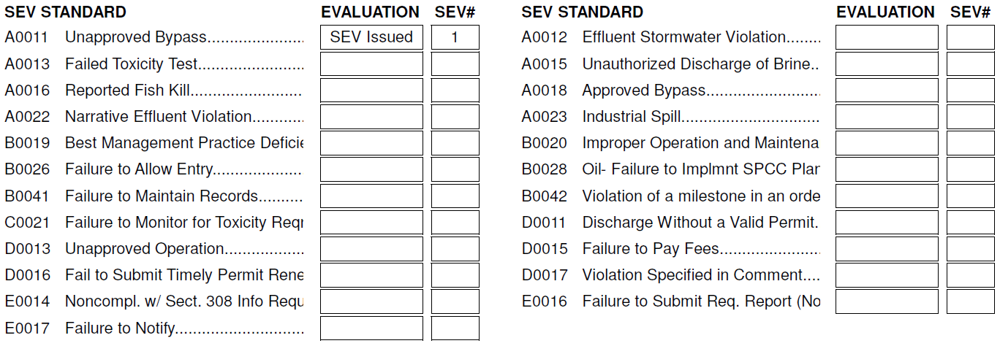
HPU Violation Categories

Slide 20
Failure to Submit Water Data
Reissuance
Table A, B, C & D analysis must be submitted
Submit analysis on each type of discharge.
All Valley Fills outlets must be analyzed separately.
Sample and analyze only flowing discharges.
New Permits and Modifications
BWQ must be established for all new or expanded discharges
Must have twelve (12) samples that were collected using the rain-gauge (7Q10) protocol.

Slide 21
Tables ABCD Water Analysis
DO NOT perform Table ABC on pooled water.
Use the Parameter of Concern (POC) worksheet.
Assures proper MDL was used by lab
Detects an exceedance of criteria before submittal
Submit the completed POC with your water analysis in the application
REVIEW YOUR ANALYSIS before submitting!!

Slide 22
Representative Outlets
Tables A,B,C,D must be submitted for each valley fill pond outlet.
Submit Tables A,B,C,D for each type of discharge, activity or operation.
An outlet can only be used to represent another outlet that monitors the same type of activity or operation and has similar effluent characterization.
DO NOT make an outlet representative of other outlets when there is a known water quality issue.

Slide 24
BWQ Collection
There is now only one collection protocol. Sampling must be collected using a rain guage to meet the 7Q10 protocol.
Samples must be current (no older than two years old) and reliable. Sampling must be conducted for no less than a six month period within a continuous twelve month period.
Analyze for all the parameters assigned by DEP
Submit all lab sheets and supporting data
Submit your data on the BWQ workbook
REVIEW YOUR WATER DATA BEFORE SUBMITTING!!

Slide 25
Failure to Address the Narrative Water Quality Standard
The NWQS must be addressed for all –
New Permits
Reissuances
Modifications
Adding new outlets
Expanding an existing discharge
Relocating or changing the outlet from a precipitation induced to “RP” (non-precipitation) type of discharge.

Slide 26
Narrative Water Quality Standard
A Narrative Justification must be submitted to establish what outlets are non-precipitation induced and status (not constructed, constructed - but not substantially complete and constructed – but substantially complete).
An AEPP must be submitted for any new or not started non-precipitation induced outlet* that is deemed to have reasonable potential.
*exceptions may apply for “Not Substantially Complete” activities – Example: When only the pond & outlet have been constructed for clearing and grubbing but dumping into the valley fill has not started.

Slide 27
Narrative Justification
Must be submitted with reissuance applications.
DO NOT WAIT for a correction requesting it.
Must adequately document and demonstrate substantially complete for each outlet that is deemed to have reasonable potential.
Status (Active, Reclaimed, Phase Released, etc.)
Pictures (Show what the site looks like)
Detail what you have done to minimize or prevent impact, that could/would have been applied through an AEPP or AMP. (bulleted items)

Slide 28
Common Permit Review Issues
Failure to submit a NPDES application.
Failure to address corrections in a timely manner.
Failure to properly classify outlets as precipitation or
non-precipitation induced when addressing the NWQS or
applying for new policies to be applied to their permit.
4. Failure to apply to Abandon a Deep Mine prior to final sealing.
5. Failure to submit Module 10 information when there is
underground injection activity proposed or permitted.
6. Temporary sediment structures (commonly ditches) are
discharging without reporting through a constructed outlet.
7. Multiple extensions have been issued to permits seeking a
reissuance while the applicant is not diligently working to
complete their application, advertise or pay fees owed.

Slide 29
Failure to Submit a NPDES Application
§47-30-3.1.a. Permit Requirements. Except as authorized by a WV/NPDES permit, no person shall:
3.1.a.5. Construct, install, modify, open, reopen, operate or abandon any coal mine, coal preparation plant or coal preparation plant associated areas whenever such facilities have associated with them or might reasonably be expected to have associated with them a discharge into or pollution of waters of the State, ….
Applications are being submitted to Article 3 without a NPDES application being submitted for concurrent review. This appears to be happening in all regions.

Slide 30
Failure to Address Corrections In a Timely Manner
Upon receiving a correction for the NPDES reviewer, the applicant
has 30 days to address. If the applicant does not respond, a 14 day
Notice will be issued. If the 14 day Notice goes with no response,
the application may be denied.
If the application warrants more than two sets of corrections to
address the same deficiency, a meeting with the consultant,
Company, DEP reviewer, and Inspector shall be called by the NPDES
Permit Supervisor to resolve the issues.

Slide 31
Failure to Properly Classify Outlets
Applicants are not properly classifying outlets as being precipitation or non-precipitation induced.
Failure to properly classify outlets affects the review and final permitting decision when applying the Narrative.
This affects the review when applying the Precipitation Induced Outlet Policy, the Post-Mining Policy and the final deletion of the structure/outlet by not having the correct water data needed to process the request.

Slide 32
Failure to Properly Classify Outlets
A Proper Classification needs to be conducted by assessing many observations.
Look at the DMR’s to see if the outlet frequently discharges.
Review the Special Sampling Reports.
Just because an outlet doesn’t discharge, doesn’t mean it’s precipitation induced. Some examples of non-precipitation induced outlets are:
Outlet that receives deep mine drainage
Outlet on a deep mine wet seal (especially down-dip)
Instream outlet
Outlet that is receiving drainage from a diverted stream
Outlet that receives a pump discharge
Outlet that receives drainage from an activity that involves pumping
Outlet that is pumped to manage or prevent a discharge
Down-dip area of a surface mine
Operationally controlled – discharge only occurs when the operation is active (i.e. preparation plants)

Slide 33
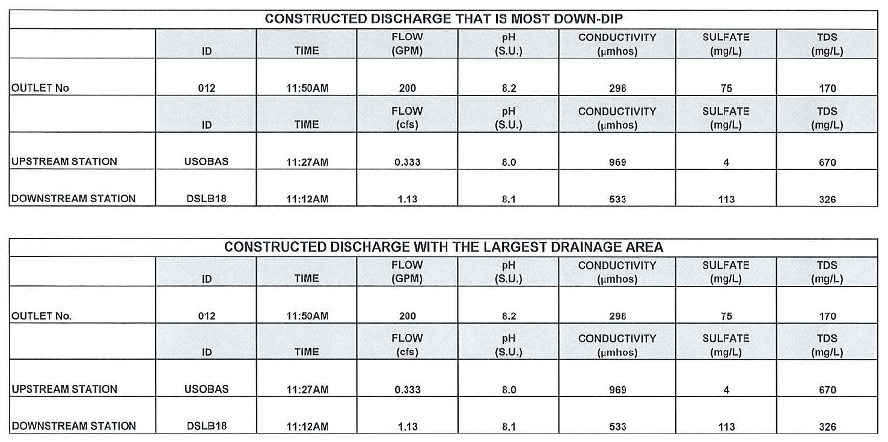
Failure to Properly Classify Outlets
Precip vs Non-Precip

Slide 34
Deep Mine Abandonment
Abandonment Plan is submitted prior and during operation.
Permit to Abandon must be addressed 180 days prior to final sealing of the mine.
Location of Dry & Wet Seals must be proposed in the Abandonment Plan and installed in the Permit to Abandon.
Final Mine Map must be submitted in the Permit to Abandon application.

Slide 35
NPDES Requirements Under 47 CSR 30
4.5.d. Plan for Abandonment and Application to Abandon a Mine.
4.5.d.1. Deep Mines. The plan for abandonment may incorporate information contained in the surface mining permit under WVSCMRA. Unless waived in writing in whole or in part by the Secretary, an applicant for a deep mine under subdivision 4.5.b. of this rule shall provide a plan for abandonment that contains the following information: (See §47-30-4.5.d)
4.5.d.4. Application for Permit to Abandon.
4.5.d.4.A. For Deep Mines. An application for a permit to abandon shall contain the information requested under paragraphs 4.5.d.1. and 4.5.d.2. of this rule, updated to show final determinations that reflect current knowledge on each item: Provided, That where the information submitted under paragraphs 4.5.d.1. and 4.5.d.2. of this rule has not significantly changed, further updating will not be required, and the following: (See §47-30-4.5.d.4)

Slide 36
Article 3 Requirements Under 38 CSR 2
38 CSR 2, 3.13. Underground Mine Abandonment Plan.
Each application for an underground coal mine operation shall contain an abandonment plan which complies with the requirements of Federal Mine Health Administration regulations at 30 CFR 75.1711. The abandonment plan shall also contain the following specifications:
3.13.a. The width of outcrop barriers;
3.13.b. The type and number of permanent seals proposed, their design details, and the proposed
materials to be used for construction;
3.13.c. The maximum head of water expected on the outcrop barriers and mine seals; and
3.13.d. The type and design details of seals for boreholes.

Slide 37
§47-30-4. Application For Permits.
4.4.b. Permit to Abandon. Any person proposing to abandon a deep mine facility under W. Va. Code § 22-11-8(b)(6) and paragraph 3.1.a.5. of this rule shall apply for an abandonment permit at least one hundred eighty (180) days prior to sealing of the deep mine.

Slide 38
Wet or Dry Seals
During the abandonment of a deep mine, openings that do not and will not have a discharge (up-dip) need to sealed with a dry or earthen seal.
If an opening has a discharge or has the potential to have a discharge (down-dip), a wet seal (pipe) must be installed in opening.

Slide 39
WET SEALS
All wet seals must have an outlet assigned to them or discharge into a structure that does.
If the outlet is assigned to a sediment structure, the outlet must be relocated to the wet seal, once the associated structure is removed.
Outlets located on wet seal must remain until final bond release and release of the NPDES permit.

Slide 40
Life For a Deep Mine After Abandonment Underground Injection

Slide 41
UNDERGROUND INJECTION (UIC)
The underground disposal of slurry, acid mine drainage sludge, or other mining wastes is regulated by both the Federal Safe Drinking Water Act and the State Water Pollution Control Act. The federal regulatory program that regulates underground disposal per the Safe Drinking Water Act is called the Underground Injection Control (UIC) Program.

Slide 42
The State has federal UIC delegation just like we have federal NPDES delegation. Chapter 22, Article 11, Section 8(b) 7 states:
(b) It is unlawful for any person, unless the person holds a permit therefor from the division, which is in full force and effect, to:
(7) Operate any disposal well for the injection or reinjection of any industrial wastes, including, but not limited to, liquids or gases, or convert any well into such a disposal well or plug or abandon any such disposal well.

Slide 43
The UIC regulations are codified in Title 47, Series 13, that regulates underground injection.
The Division of Mining and Reclamation administers the UIC program for coal related activities, and the applicant must apply to DMR to obtain an UIC permit.
Also, the NPDES permit writers need to have information on the injection activity to assess the possible impacts on the NPDES permit for the surface discharges. Module 10 must be submitted to address the proposed activity.

Slide 44
For example; if a deep mine that being injected in to has a discharge, the NPDES permit must assign effluent limits to any point where surface discharge may occur from that deep mine.
In addition, the deep mine being injected into requires an update to the Abandonment Permit to detail changes that is and will be occurring from the injection.

Slide 45
Sediment Control Temporary vs Permanent
NPDES does not have different rules governing temporary and permanent discharges. If a point source is created as a result of a pipe, spillway or other design for drainage to exit from an area that is associated with mineral removal process, that discharge must be monitored by a permitted outlet.

Slide 46
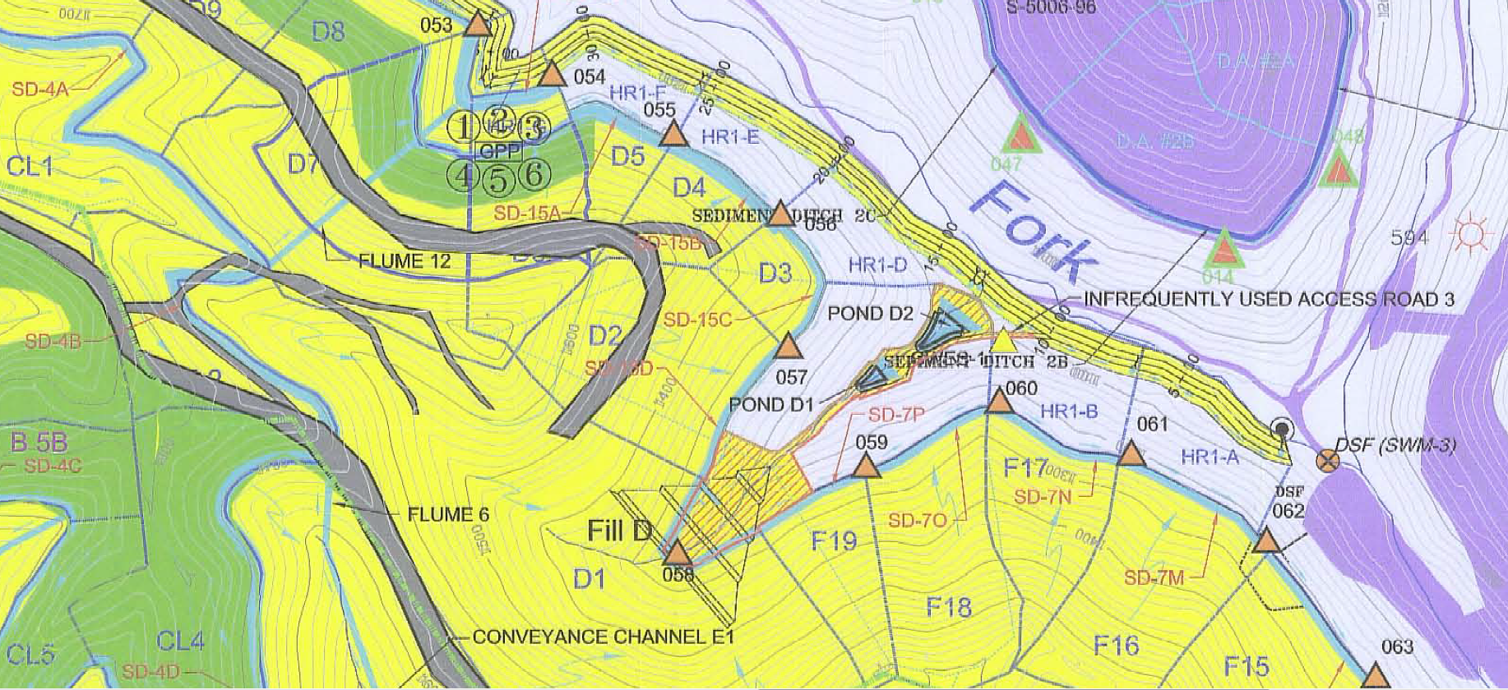
DRAINAGE MAP

Slide 47
Drainage Map vs Google Earth

Slide 51
What Should We Do
Outlets assigned to a permitted structure in the same drainage area may be temporarily assigned to a temporary sediment structure during interim mining phases.
This will not require a modification to the NPDES permit to temporarily relocate the outlet.
This will not require a modification to re-calculate the outlet’s limits, as long as the outlet is still located in the same permitted drainage area.

Slide 52
Permit Extensions
Administrative Extensions may be applied to expired permits when a reissuance is “actively” be pursued by the applicant.
Applications that are not being pursued will not be extended.

Slide 53
Permit Extensions
Administrative Extensions may also be used to extend an expired permit with a Phase 3 Release pending issuance. If the Phase 3 will allow the NPDES to be released, there is no reason to reissue the permit just to release it a short time later.

Slide 54
Permit Extensions
Expired permits cannot be modified while they are administratively extended.
Try to submit only “minor” necessary alterations with a reissuance.
Do not complicate the application.
This should expedite the review and processing of the application.

Slide 55
Hopeful Outcome
Promote complete submittals
Eliminate multiple sets of corrections
Expedite processing of permit
Identify problem areas
Correct the process
Provide training to industry and DEP staff
Issue a better Permit

Slide 56
Questions / Suggestions
Please contact us
William.C.Borth@wv.gov
Mark.J.Parsons@wv.gov

