Slide 1

Industry Training
NPDES
Session 3
Policies and Procedures
August 22. 2018

Slide 2
Post Mining Limits Under 47 CSR 30
Dated January 3, 2014
Revised October 5, 2017

Slide 3
Post Mining Limits Under 47 CSR 30
Dated January 3, 2014
Under 40 CFR § 434.11(k), the following operations are classified as a Post Mining Areas:
(1) A reclamation area, which is the surface area of a coal mine which has been returned to required contour and on which revegetation (specifically, seeding or planting) work has commenced, or
(2) The underground workings of an underground coal mine after the extraction, removal, or recovery of coal from its natural deposit has ceased and prior to bond release.

Slide 4
Post Mining Limits Under 47 CSR 30
Dated January 3, 2014
The determination for classification as a Post Mining Area is based on three factors:
(1) Mining in the area is completed;
(2) The surface area has been returned to contour; and
(3) Revegetation has commenced.
Summary – The coal is removed, area is backfilled, graded and seeded.

Slide 5
Post Mining Limits Under 47 CSR 30
Dated January 3, 2014
This determination is made on an outlet-by-outlet basis.
The drainage area associated with each outlet will be assessed individually to determine whether each of the three factors is satisfied.
It is possible for one or more outlets to be classified as a Post-Mining Area, while other outlets do not qualify for reclassification.

Slide 6
Post Mining Limits Under 47 CSR 30
Revised October 5, 2017
Precipitation-Induced Outlets. Prior to applying for post-mining limits, the permittee must provide one of the following data sets for each outlet:
Twelve (12) months DMR data plus 1 raw sample, if the outlet is not chemically treated;
Six (6) months of raw sample data collected prior to any chemical treatment;
If the outlet does not flow consistently, only flows in response to precipitation event, 12 months DMR data plus 1 raw sample (no pooled samples) with confirmation from the DEP inspector; OR
If the outlet does not discharge, 12 months of DMR demonstrating no flow with confirmation from the DEP inspector.

Slide 7
Post Mining Limits Under 47 CSR 30
Dated January 3, 2014
The data will be compared to the corresponding outlet’s effluent limitations.
If the data meets all WQBELs in the permit, then the outlet will be assigned the appropriate TBELs for a Post-Mining Area specified in 40 CFR 434.
WQBELs will remain in the permit for any parameter that does not meet the effluent limitations set forth in the NPDES permit.

Slide 8
Post Mining Limits Under 47 CSR 30
Revised October 5, 2017
Non-Precipitation Induced outlets. Prior to applying for post-mining limits, the permittee must
provide 12 months raw water data for each outlet, prior to any treatment (chemical or physical). This sample needs to be taken prior to the water entering the associated control structure. All observed sources of flow, i.e. valley fill toes, deep mine discharge seals, must be sampled individually at the point of flow origin, even if they have a common outlet ( same as required by sediment control structure removal guidance).
The agency will compare the data to the applicable water quality criteria. If the data does not exceed the corresponding water quality criteria, then the outlet will be assigned the appropriate TBELs for a Post-Mining Area specified in 40 CFR 434.
WQBELs will remain in the permit for any parameter that exceeds the applicable water quality criteria in the receiving stream.

Slide 9
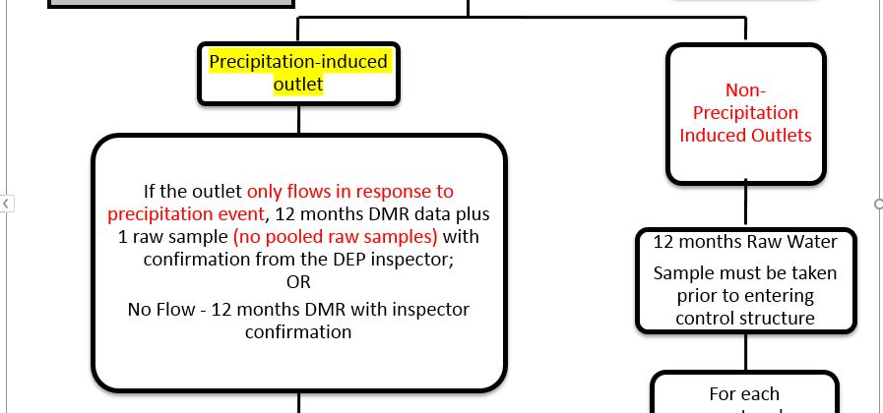

Slide 10
Permit Writer’s Input (Unfiltered)
Most Frequent Issues Found in Application Review
Submitting for Post Mining with incomplete water data—if one sample for the month, they don’t have documented that the other sample time was NF. They just submit the one and expect you to know whatever the reason. Water data that is missing the required sampling parameters and frequency. And sometimes enough samples.

Slide 11
Permit Writer’s Input (Unfiltered)
Most Frequent Issues Found in Application Review
We still have a lot of issues with post mining limits. The companies submit just a blanket request of post mining limits for outlets with incomplete data requiring multiple rounds (3-5) of corrections. I know the policies are pretty clear on what is required for post mining limits. I don’t know if they don’t read the policies or don’t understand them. Anyway that is probably the most common misunderstanding of procedures and policies from applicants.

Slide 12
Permit Writer’s Input (Unfiltered)
Most Frequent Issues Found in Application Review
The only problem I have run into is on Post Mining Limitations. When some of the parameters in the raw water is above their water quality standard, but the DMR’s shows it below the water quality standard. The company calls me and questions why all the parameters were not removed.

Slide 13
Permitting Policy for Instream
Station Monitoring Frequency
Dated February 9, 2017

Slide 14
Permitting Policy for Instream Stations
Dated February 9, 2017
This memorandum establishes the requirements and procedures for reducing the monitoring frequency for instream monitoring stations.
Instream monitoring is required in a permit to ensure the discharge from the mining activity does not cause or contribute to a violation of the water quality standards.

Slide 15
Dated February 9, 2017
Permitting Policy for Instream Stations
Normally, the monitoring frequency assigned to instream stations is the same as the associated NPDES outlets.
In most cases for active operations the frequency is semi-monthly.
Frequency was commonly reduced to quarterly when outlets go to post mining.

Slide 16
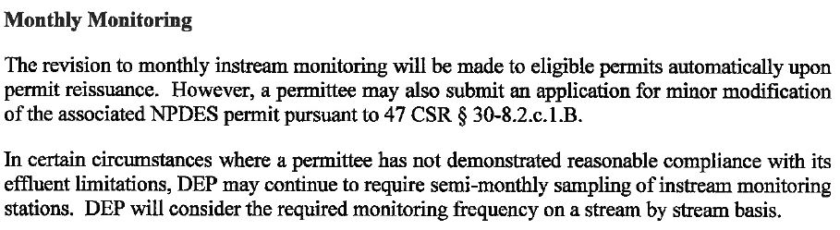
Permitting Policy for Instream Stations
Dated February 9, 2017

Slide 17
Permitting Policy for Instream Stations
Dated February 9, 2017
This policy allows the frequency for instream monitoring to be reduced to monthly automatically upon permit reissuance if the permit is in (reasonable) compliance with its effluent limitations.
Permits may request the instream station’s frequency to be reduced by way of a minor modification. No advertisement is required.
Reduced monitoring frequency shall be assessed and granted on a stream by stream basis.

Slide 18
Permitting Policy for Instream Stations
Dated February 9, 2017
Quarterly instream monitoring may be requested if all the following circumstances are met:
  The mining activities have been ongoing for at least two years or mineral removal is complete and final land reclamation has been initiated.
  No violations of effluent limitations have occurred for the associated outlets for at least two years.
  The permittee has received no violations for “conditions not allowable” in the receiving stream for at least two years.

Slide 19
Permitting Policy for Instream Stations
Dated February 9, 2017
Quarterly instream monitoring may be requested if all the following circumstances are met:

Slide 20
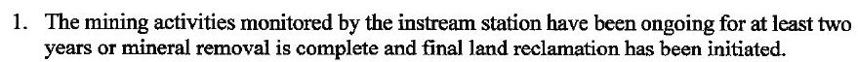
Permitting Policy for Instream Stations
Dated February 9, 2017
Quarterly Monitoring

Slide 21
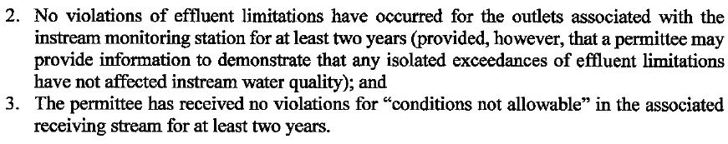
Permitting Policy for Instream Stations
Dated February 9, 2017
Quarterly Monitoring

Slide 22
Permitting Policy for Instream Stations
Dated February 9, 2017
Quarterly Monitoring

Slide 23
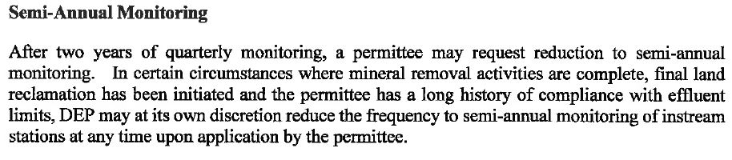
Permitting Policy for Instream Stations
Dated February 9, 2017
Semi-Annual Monitoring

Slide 24
Permitting Policy for Instream Stations
Dated February 9, 2017
Permit Condition Showing Instream Station Monitoring Frequency
D.8 Instream Station Monitoring frequency:
Instream Station monitoring frequencies are as follows:
All other requirements of Section D 3 apply as specified.
USTB- Semi-Monthly
DSTB-Semi-Monthly
USRB-Monthly
DSRB-Monthly
USDCC-Quarterly
DSDCC-Quarterly
Or if all are the same frequency:
All stations -Monthly (or whatever frequency is applicable)

Slide 25
Permitting Policy for Precipitation Induced Outlets
Dated November 28, 2016

Slide 26
Permitting Policy for Precipitation Induced Outlets
Dated November 28, 2016
This policy establishes the procedures and practices for permitting precipitation induced outlets to coincide with our permitting of such outlets with respect to our Narrative Water Quality Standards.
The Narrative Guidance does not apply to outlets that are precipitation induced.
Water quality effluent limits need not be applied to precipitation induced discharges.

Slide 27
Permitting Policy for Precipitation Induced Outlets
Dated November 28, 2016
Precipitation induced outlets will have technology based effluent limits along with benchmark monitoring criteria for instream monitoring stations.
This policy defers a BWQ Tier 2 Antidegradation review in lieu of establishing benchmarks in the receiving stream.
BWQ collection shall be done using the 7Q10 “rain gauge” protocol only.
Any Tier 2 review will not include acreage contributed from precipitation outlets. Only non-precip outlets will be assessed.

Slide 28
Permitting Policy for Precipitation Induced Outlets
Dated November 28, 2016
New permits, permit modifications and reissuances will be permitted in accordance with this policy.
NPDES permits will be revised to be consistent with this policy upon reissuance.
A permittee may apply for a Major Modification to apply this policy prior to reissuance of the permit.
The permit modification will be considered on an outlet by outlet basis and may be granted only if the permittee can demonstrate that each requested outlet discharges solely in response to precipitation events

Slide 29
Permitting Policy for Precipitation Induced Outlets
Dated November 28, 2016
The review will be conducted on a parameter by parameter basis. No change will be available for any parameter which effluent limitations were established in accordance with an approved TMDL or where the immediate receiving stream is listed as impaired in the operative 303d list.

Slide 30
Permitting Policy for Precipitation Induced Outlets
Dated November 28, 2016
For other parameters not included in the ELG’s (40 CFR 434) but may require limitations to be applied; the most stringent acute value will be assigned.
When additional parameters are added to the outlet(s), an instream benchmark value must be added to the permit condition utilizing the most stringent chronic criteria.
Aluminum – Where applicable, surrogate tech-based limitations of 3.0 mg/l AML and 6.0 mg/l MDL shall be applied for Total Aluminum.
Selenium – Where applicable, outlets will be assigned “report only” monitoring for the AML and MDL.

Slide 31
Permitting Policy for Precipitation Induced Outlets
Dated November 28, 2016
The new Precipitation Induced Outlet Condition replaces the Special Sampling Condition.
The language and specifics are the same, except the new Precipitation Induced Outlet Condition contains a set of Benchmark values to be applied to the instream monitoring stations.
The benchmark values will be specific to the parameters of concern and the type of stream (warm or cold water).

Slide 32
Precipitation Induced Outlet Condition
In the event of a rainfall event equal to or greater than 0.3 inches occurs, during each calendar month monitoring will be conducted for the constructed on-bench outlet (precipitation induced) which has been disturbed by mining activity with the largest component drainage area and the constructed on-bench outlet (precipitation induced) at the lowest elevation on the down dip portion of the operation that has been disturbed by mining activity. The stream monitoring stations associated with these outlets must also be monitored at approximately the same time. The monitoring can be initiated at any point after rain gauge data indicates 0.3 inches of precipitation has occurred and shall be completed within eighteen (18) hours after cessation of the precipitation event. A qualifying event defined herein as any event where 0.3 inches or more of rainfall occurs within a consecutive 24 hour period.
In the event of a discharge from the precipitation induced outlets is sampled, the sample(s) must be analyzed for all parameters listed in Section A of the permit for each respective outlet and parameters listed in Section D,3 of the permit for the associated stream monitoring station(s). Analysis must be reported as a regular discharge monitoring report (DMR) and may be substituted for one of the required semi-monthly samples for the outlet(s). Once a qualified event is sampled in a given calendar month, this condition is satisfied for that calendar month. Rain gauge information must be maintained during the term of the life of the permit and made available to the Director upon request.

Slide 33
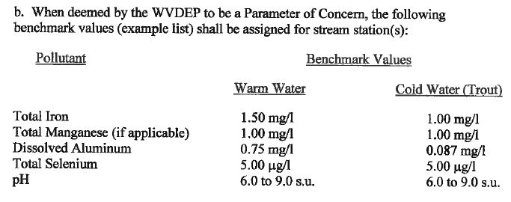
Precipitation Induced Outlet Condition

Slide 34
Permitting Policy for Precipitation Induced Outlets
Dated November 28, 2016
New Reporting Forms must be completed, signed and submitted with the ESS Quarterly Discharge Monitoring Report (DMR) submittal.
The original signed form(s) must be submitted to the permit inspector in the appropriate regional office.

Slide 36
Permit Writer’s Input (Unfiltered)
Most Frequent Issues Found in Application Review
I am noticing the NWQS justification is not being compiled correctly. Companies are not justifying Non Precip vs Precip.
They want to call everything substantially complete.
NWQ needs more detailing.

Slide 37
Permit Writer’s Input (Unfiltered)
Most Frequent Issues Found in Application Review
Provide better description in Module 11 Narrative and make sure it matches what is being requested in the Art. 3 application if associated.
Make sure they are using the correct BWQ protocol now for non-precip outlets.
Provide Table C analysis. They have 2 years prior to collect this data but are submitting without. Also delays when an issue pops up with that analysis causing delays in permitting times.

Slide 38
Permit Writer’s Input (Unfiltered)
Most Frequent Issues Found in Application Review
Provide better description in Module 11 Narrative and make sure it matches what is being requested in the Art. 3 application if associated.
The companies and consultants understand the new policies to the point of asking for them in a permitting action. However, they are failing to add the supporting documents necessary to be granted the policies that grant any type of relief. This requires one and sometimes two rounds of corrections for the supporting documentation.

Slide 39
Permit Writer’s Input (Unfiltered)
Most Frequent Issues Found in Application Review
Companies not resubmitting the corrections within 30 days is becoming a real problem.
We also need to remind the companies that when a permitting action is submitted they also need to submit the required filing fees associated.
Make a quick word to them about submitting incomplete applications, no water data, which they are just trying to get an application in and get out of hot water with I & E.

Slide 40
Questions ?

