Slide 1

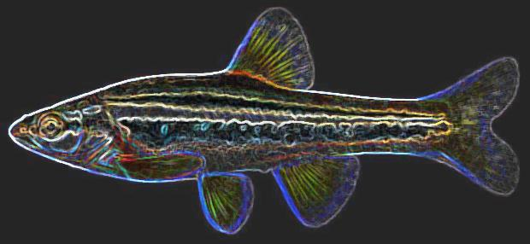

WV Selenium Chronic Aquatic Life Standard Implementation - Revision 4

Slide 2
Significant policy revisions on 9/10/18
Applies largely to application in NPDES permitting
Keeps previous approach of bioaccumulation factor (BAF) calculation
Provides additional option to measure compliance directly through analysis of fish tissues
Shortens requirement to redo fish for BAF approach from 3 years to at reissuance unless < 1 year

Slide 3

BAF calculation approach (a review)
Study plan for single visit survey site and applied to outlets using watershed approach where applicable
  WVDEP approval required
Fish tissue and water samples collected per sample plan
  Multiple tissue composites of fillet, egg/ovary, or whole body
  Minimum 6-12 months of water chemistry
Calculate protective water column concentration (PWCC)
  Input average aqueous concentration and highest tissue concentration
Use TSD to calculate NPDES limits for outlets using PWCC

Slide 4
BAF calculation approach (a review)
Re-caluate BAF derived limits at permit reissuance (>1 year)
To date 111 study plans have been submitted encompassing around 200 study sites
15 permits have been approved, 3 are under review currently
Lowest selenium limit to date 5.0 µg/L monthly average & 8.7 µg/L daily max
Highest selenium limit to date 22.1 µg/L monthly average & 38.3 µg/L daily max
Median limits are 9.95 µg/L monthly average & 17.15 µg/L daily max
EPA is thoroughly reviewing all applications and commenting on every one
  Have suggested denial of several permits
  BUT have not submitted any objections

Slide 5

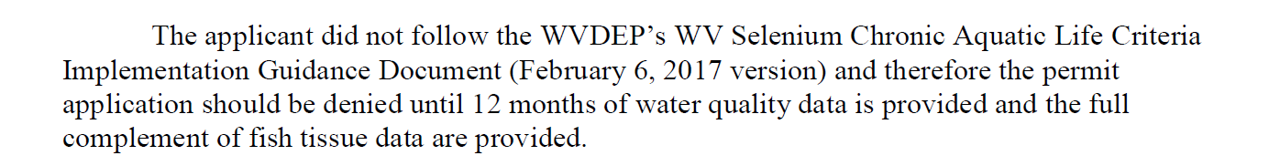

Slide 6

Additional approach: Semi-annual compliance monitoring of fish tissues
Applied to discharging outlets only
Study plan for multiple visit survey site and applied to outlets for direct measure of compliance
Fish tissue limits placed on outlets of 8 mg/kg whole body dry selenium
Downstream compliance point proposed in study plan at first practicable location with sampleable fish population
  Must be approved by WVDEP

Slide 7
Additional approach: Semi-annual compliance monitoring of fish tissues (ctd.)
Baseline fish tissue survey conducted at compliance point
  Establishes compliance with standard and sets expectation of species composition
  Requires collection of tissue composites and a single water sample
  Can be collected from August 1 to March 1
Fish tissues collected at compliance point semi-annually in two seasons
  Summer: August 1 – October 1
  Winter: December 1 – March 1
  Initial semi-annual samples set target sample dates for future sample events
Must report highest composite tissue concentration in DMRs

Slide 8
Additional approach: Semi-annual compliance monitoring of fish tissues (ctd.)
Semi-annual results submitted to WVDEP within 60 days of collection
  Lab results (tissue & water), dry weight calculation, site & composite pics, field forms
Water samples collected monthly
  Report only pH, flow, selenium at stream station (compliance point)
Company may request review of monitoring data after ≥ two years (5 samples)
  If tissue and chemical data support it, reduced monitoring frequency may be granted
PWCC calculated and applied to outlets if tissue limits are violated more than 2 times in rolling 24 month period

Slide 9
Outfalls
Permit 1
Permit 2
Permit 3
Permit 4
Fish tissue study site

