Slide 1
Pits and Impoundments
Natural Gas Horizontal Well Control Act
West Virginia Department of Environmental Protection
Office of Oil and Gas
W.Va. Code §22-6A
Scope of Legislation
Applicability to Impoundments
Policies
Procedures
Implementation
Presented by John Kearney, AMENDED – May 18, 2012

Slide 2
Scope of Legislation as it relates to Impoundments and Pits
Office of Oil and Gas
Three Sections:
§22-6A-9. Certificate of Approval
Establishes rules for Pits and Impoundments not associated with a specific well work permit (Centralized).
Mandates Centralized Pits and Impoundments receive Certificate of Approval.
Similar to Dam Safety Rules.
(h) Each certificate of approval issued by the secretary pursuant to the provisions of this article may contain other terms and conditions the secretary prescribes.

Slide 3
Scope of Legislation as it relates to Impoundments and Pits, continued.
Office of Oil and Gas
§22-6A-10. Notice to property owners.
Requires notification of centralized impoundment to owners of the surface tract prior to installation of impoundment. Also, because this activity is not associated with the permitted well work, a surface use agreement will be required for the placement of impoundments or pits
§22-6A-23. Impoundment and pit safety study; rulemaking.
Mandates that by January 1, 2013, DEP reports to the Legislature on the safety of pits and impoundments utilized pursuant to section nine of this section.
Upon a finding that greater monitoring, safety and design requirements or other specialized permit conditions are necessary, the secretary shall propose for promulgation legislative rules establishing these new requirements.

Slide 4
Definitions
Office of Oil and Gas
The following definitions are to be used:
Impoundment – “A man-made excavation or diked area for the retention of fluid.” By convention - containing freshwater only.
Pit – “a man-made excavation or diked area that contains or is intended to contain an accumulation of process waste fluids, drill cuttings or any other liquid substance generated in the development of a horizontal well and which could impact surface or groundwater.” Any mixture of waste will classified as a pit.
Centralized – an impoundment or pit that is NOT on a permitted drilling location.
Associated – an impoundment of pit that IS on a permitted drilling location.
Certificate of Approval – a formal approval for centralized impoundments or pits.

Slide 5
Applicability of §22-6A-9
Office of Oil and Gas
Impoundments greater than 210,000 gallons (5,000 bbls).
Above ground diked impoundments greater than 210,000 gallons. (Portable temporary structure, not tanks)
Impoundments not associated with a specific well work permit.
Establishes rules and procedures to issue Certificate of Approval for impoundment and pits NOT associated with well permits.
Exceptions:
Impoundments associated with well work permit.
Farm Ponds.

Slide 6
Exceptions to §22-6A-9
Office of Oil and Gas
Let’s get the exceptions out of the way.
Associated Impoundments:
Nothing has change by this legislation.
Regulated by W. Va. Rule § 35-4-21
Reclamation time frames same as well pad.
We will standardize communication process, forms, submittals.
We will also begin assigning numbers to all impoundments and enter in our ERIS data base.
You will submit these on paper and via Email.
New Email: depimpoundments@wv.gov

Slide 7
Exceptions to §22-6A-9, cont.
Office of Oil and Gas
Farm Ponds
Farms Pond are exempt from Certificate of Approval rule.
They are not exempt from US Army Corps of Engineer or USEPA.
United States Department of Agriculture’s Natural Resources Conservation Service “Conservation Practice Standard - Ponds” (Code 378)
There are standards for placement in low hazard area, and design standards for spillway, drainage area, size and use.
Farm Pond Fact Sheet – Farm Pond Standard – See Appendix
Pay attention to US Army Corps of Engineer and EPA Clean Water Act regulations.

Slide 8
Centralized Impoundments §22-6A-9
Office of Oil and Gas
Scope of Legislation:
Centralized pits (not on a well permit) will require a Certificate of Approval.
This is very similar to a Dam Safety Certificate of Approval.
Good for one year, renew annually, application fee $300, annual $100.
To enlarge, alter, repair, remove or abandon an impoundment will require a modification to the Certificate of Approval, $300 Fee.
Designs and plans will be charge of Professional Engineer, registered in WV.
You have the right to appeal.
You have six months to reclaim impoundment after expiration of approval.
New forms
Waste pits have more stringent design standards.

Slide 9
Application Process
Office of Oil and Gas
Submit Application and Plans
Application – basic information
With an Impoundment Certificate of Approval application, you will include:
Engineered Construction Plans , WV P.E. Certified
Erosion and Sediment Control Plan, WV P.E. Certified
A Reclamation Plan – Post-Construction and Post-Use, WV P.E. Certified .
Impoundment Monitoring Plan, WV P.E. Certified
Impoundment Maintenance and Emergency Plan, WV P.E. Certified
Water Management Plan. How will you fill it? You will reference this water management plan once water begins moving to satellite well pads.
Notifications: - See §22-6A-10
To surface owner. Copies of proof of delivery will be included with application.
Also notice the above people within 7 days, but not less than 2 days, of the start of construction.

Slide 10
Elements of Plans
Office of Oil and Gas
Engineered Plans.
Waste Pits have more safe guards; duel liners, leak detection, groundwater monitoring.
Reclamation Plans.
Post-construction reclamation plan – after you’ve built it.
Post-closure reclamation plan - after you’ve closed it.
Maintenance Plan.
Scheduled maintenance, routine repairs.
Monitoring and Emergency Plan.
Inspections, emergency planning, and response. You will evaluate the location of impoundments and classify using dam safety Hazard Classification criteria.

Slide 11
Elements of Plans
Office of Oil and Gas
Monitoring and Emergency Action Plan
Hazard Classes
Class 1 (High Hazard)
Class 2 (Significant Hazard)
Class 3 (Low Hazard)
Class 4 (Negligible Hazard)
Hazard Evaluation – The applicant will survey surrounding area for potential hazards should pit or impoundment fail, paying attention to homes, structures, roads, etc.
Example plans are coming. Modeled on Dam Safety regulations.
Location and classification of new centralized impoundments will impact your emergency plan and how you prepare for an emergency.
Monitoring and Emergency Action Plans will detail monitoring and emergency notification and procedures, and assess risk.
Surface Owner Agreements
Centralized impoundments and pits will be constructed on landowners who enter into lease agreements with you.

Slide 12
Water Management Plans
Office of Oil and Gas
Water Management Plans (WMP)
A WMP will be needed to fill your impoundment. Will also be needed if you will plan on diluting a waste pit with freshwater from a stream source (greater than 5,000 bbl. / month).
Apply for WMP concurrently with Impoundment application or prior.
A centralized impoundment WMP can be referenced for well pads.
Will integrate with other WMP plans. Waste pits will be referenced in other WMP disposal. Waste pits may also be sources of other WMP.
Waste Pits may need WMP if receiving water from stream or water utility.

Slide 13
A Word About Dams
Office of Oil and Gas
Do not build a dam unless you intend to build a dam.
Definition: - (See Impoundment Page Dam Definition)
This is an option if you are willing to design and build to dam specifications.
Height and volume driven.
25’ tall embankment and 15 acre feet of water (116,375 bbls, 4.8 million gal)
OR
6’ tall embankment and 50 acre feet of water (387,917 bbls, 16.2 million gal)
Impoundments often exceed the volume limit, but not the height limit.
Incised volume does not count to total volume.
Embankment height is key to definition of a dam. How to measure ? Where to measure from ? Generally, the base of any earth disturbance on the embankment.

Slide 14
Appropriate Location – Due Diligence
Office of Oil and Gas
Per 35-4-21.1 “All pits and impoundments with capacity of greater than five thousand (5,000) barrels used in association with an oil and gas operation, shall be constructed only in locations appropriate for the storage of water, including wastewater, and shall be designed, constructed, located, maintained, and used in accordance with this rule and in such a manner as to minimize adverse environmental effects and to assure safety to the public.”
Responsibility of operator to consider history of location. Some historical mining locations may present water quality problems. Former industrial location could also present problems.
Assure safety to surrounding communities, people, and environment.

Slide 15
Application Forms
Office of Oil and Gas
To standardize how we communicate about impoundments, New impoundments and pits forms have been created:
“Permit Associated Impoundment / Pit Registration”
“Centralized Impoundment / Pit Application”
Basic information will be captured.
It will have checklists for required information and additional plans.
All impoundments will get a number. We need to standardize names for tracking purposes.
Remember standard nomenclature:
Impoundment = Freshwater
Pit = Waste
All forms available at www.dep.wv.gov/oil-and-gas/impoundments

Slide 16
Application / Approval Process
Office of Oil and Gas
Centralized Impoundments and Pits – “How-To”
Complete and submit “Centralized Impoundment / Pit Application”.
Show proof of surface owner notification requirement.
Include all required plans, including Water Manage Plan.
Water Management Plan will be forwarded by OOG to Water Use section for review and approval.
Office of Oil and Gas will review application and plans.
Oil and Gas Inspector will visit to review Erosion & Sediment Control Plan.
WMP gets approved.
Application is approved then given “Certificate of Approval”.
You will receive “Certificate of Approval” and impoundment number.
At least 7 days prior to construction commencement, complete “Notification of Impoundment / Pit Construction”. Submit a copy of this form to Office of Oil and Gas, local Oil and Gas Inspector, and those requiring notification.
Build impoundment or pit.
Remember the WMP notification requirement prior to filling.
Submit As-built P.E. Certification (and other Waste Pit certified plans, required before filling.
You may now fill the impoundment or pit.

Slide 17
Application / Approval Process
Office of Oil and Gas
Associated Impoundments and Pits – “How To”.
Apply for well work permit as usual with impoundments included in your construction drawings, E&S Plans, etc.
Complete and submit “Permit Associated Impoundment / Pit Registration” with the application.
An impoundment number will be assigned and sent to you.
At least 7 days prior to construction commencement, complete “Notification of Impoundment / Pit Construction”. Submit a copy of this form to Office of Oil and Gas and to local Oil and Gas Inspector.
Build it.
Submit P.E. Certified As-Built Certification.
Fill the impoundment or pit.
Notes on Water Management Plans.
Since associated impoundments will be associated with a drilling permit, you will have already applied for a water management plan, or have done so concurrently. If you have an approved WMP, provide this number on application. If not, notify as “pending”. In no case will you pump large volumes of water without an approved WMP.

Slide 18
Impoundment Numbers
Office of Oil and Gas
Examples of Types
000-FWC-0001 000-WPC-0001
000-FWA-0001 000-WPA-0001
Explanation of Number and Types
000 = County Code
FWC = Fresh Water – Centralized – Impoundment –not associated with API permit
FWA = Fresh Water – Associated – Impoundment –associated with API permit
WPC = Waste Pit – Centralized – Pit not associated with API permit
WPA = Waste Pit – Associated – Pit associated with API permit
0001 = Sequentially numbered by county

Slide 19
Centralized Pits - Key Elements
Office of Oil and Gas
Centralized Pits will require geotechnical and groundwater investigation.
More upfront planning and design.
Groundwater wells, groundwater monitoring.
Duel 60 mil liners, leak detection zone.
Details available in “Design and Construction Standards for Centralized Pits”.
These requirements are in the process of being codified.

Slide 20
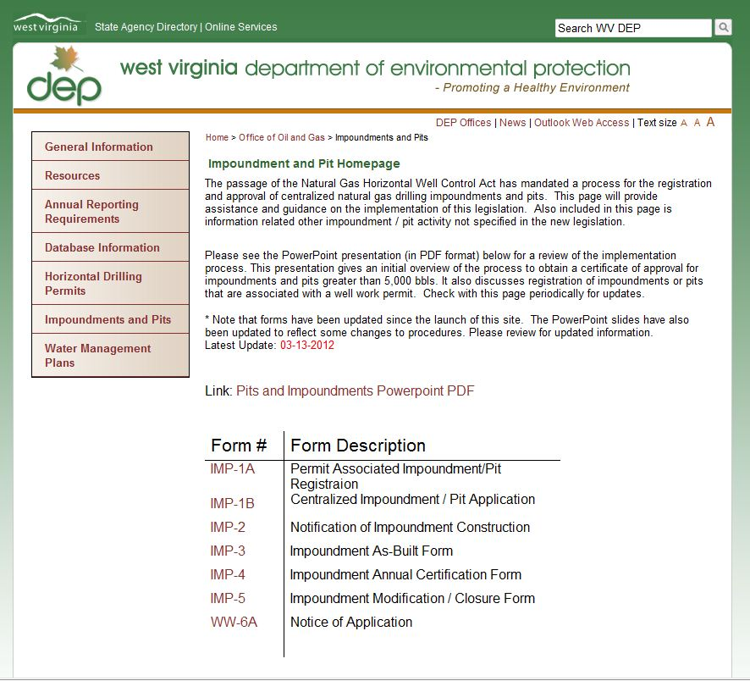
All information available on internet: http://www.dep.wv.gov/oil-and-gas/Impoundments
Office of Oil and Gas

Slide 21
Plan Submittal
Office of Oil and Gas
Submit original paper copy of application to:
West Virginia Department of Environmental Protection
Office of Oil and Gas
Impoundment Registration
601 57th Street, SE
Charleston WW 25304
Email PDF file format of this application and all related engineering Plans to :
Depimpoundments@wv.gov
Any Questions can be forwarded to:
John Kearney
WV DEP Office of Oil and Gas
John.J.Kearney@wv.gov

Slide 22
List of Forms and References All Forms and References will available on Office of Oil and Gas Web Page
Office of Oil and Gas
Forms | References
Permit Associated Impoundment / Pit Registration - Form IMP-1A - Link | Natural Gas Horizontal Well Control Act; W.Va. Code §22-6A
Centralized Impoundment / Pit Application - Form IMP-1B - Link | W.Va. Code §35-4-21 Construction of Pits and Impoundments with Capacity of Greater Than 5,000 bbl
Notification of Impoundment / Pit Construction - Form IMP-2 - Link | W.Va. Code §47-34 Dam Safety Rule
Impoundment As-Built Certification - Form IMP-3 – Link | United States Department of Agriculture’s Natural Resources Conservation Service “Conservation Practice Standard - Ponds” (Code 378)
Centralized Impoundment / Pit Annual Recertification - Form - Link | Farm Pond Fact Sheet
Centralized Impoundment / Pit Modification and Closure Form – Link | Design and Construction Standards for Centralized Pits
Notice of Application– Form WW-6A Link | Example Monitoring and Emergency Plan
 | Example Maintenance Plan

Slide 23
FAQ
Office of Oil and Gas
Q. Can we build an impoundment next to a permitted location, call it “centralized”
and get a certificate of approval for it?
Yes, if you have a surface use agreement with the surface owner. These impoundments are not on the permitted location. Also, they should be designed to maintain some degree of separation from permitted pad LOD. The two activities can not interfere with reclamation of the other. They will also require their own plans.
What about next to an existing, permit released pad?
A. Yes, if you don’t disturb the well pad.
Q. If WV DEP give us a certificate of approval, are we exempt form US Army Corps
of Engineer issues?
No. The Corp of Engineers is diligent in their role of enforcing permitting
requirements for work in the waters of the United States of America. You should
consult with them before doing stream work.

Slide 24
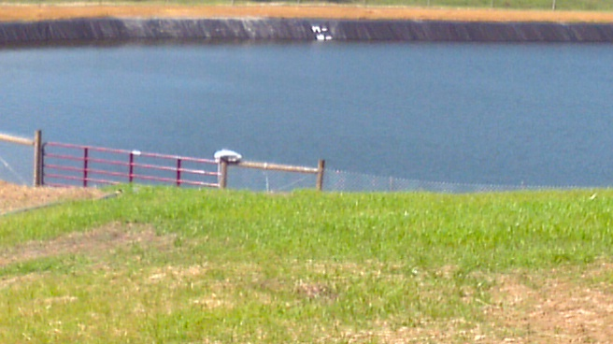
Good Ideas
Office of Oil and Gas
Water Level Markings
Water Level in feet.
Better monitoring, detect leaks

Slide 25
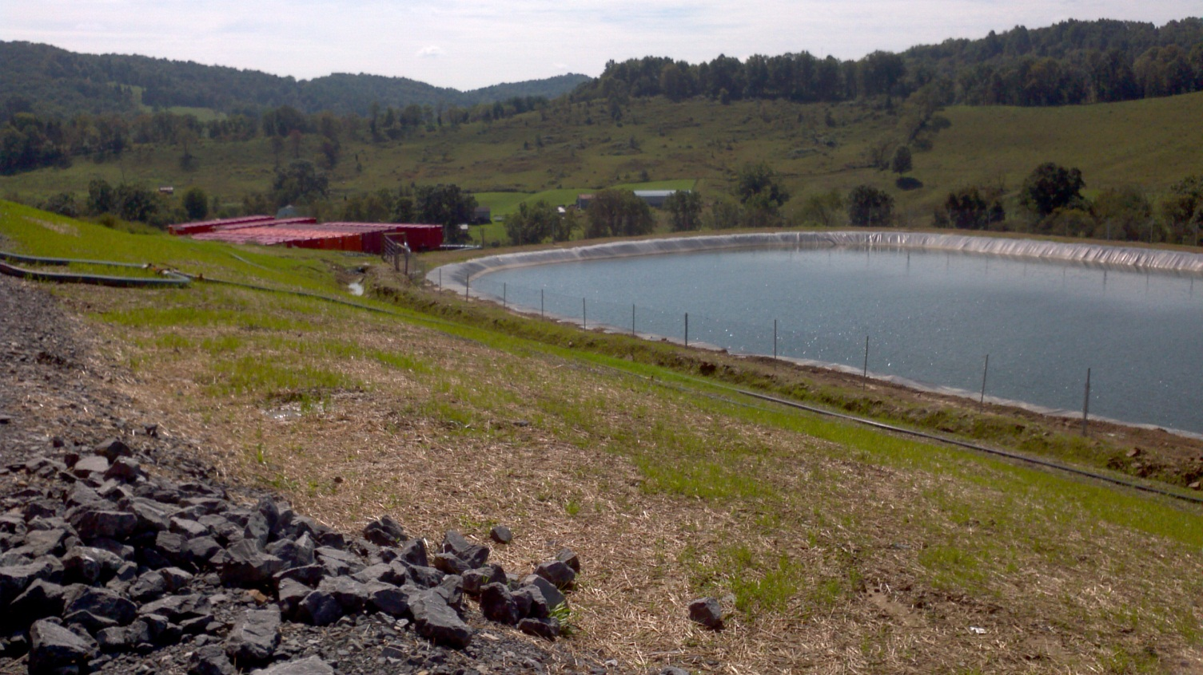
Good Ideas
Office of Oil and Gas
Fence is up
Neat location
Good Berms and ditches
Good Vegetation and veg. control.
Well Maintained

Slide 26
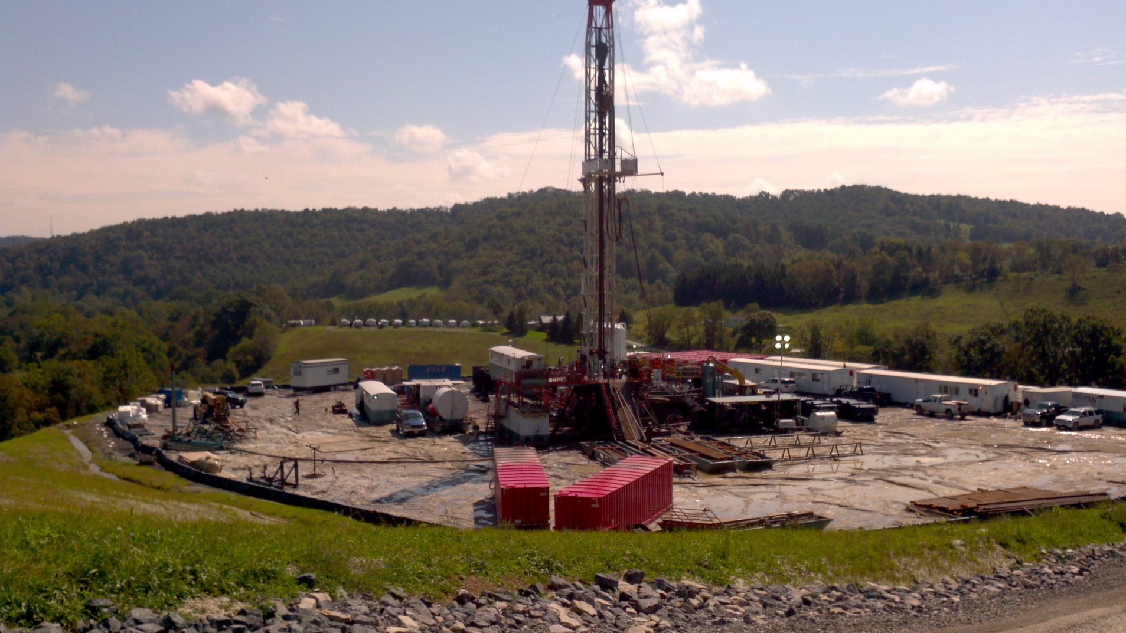
Questions
Office of Oil and Gas

